Slide 1
Preface
This slide desk was developed to help practitioners answer common questions asked by their leadership considering STPA adoption. If you are in that situation, feel free to use these slides and tailor them for your organization.
The most convincing evidence for STPA will come from trying it on your own application and seeing the results first-hand, not this slide deck. However, in organizations where innovation is not routine, a paradox can arise where leadership hesitates to try something new until there is proof that it will work, yet you can’t produce the proof they want without implementing the new idea.
These slides attempt the next best solution, which is to present some of the evidence and data points shared by others who have used STPA.
Suggestions and ideas about these slides are welcome. Email jthomas4@mit.edu

Slide 2
Preface: This slide deck is part of a roadmap
Example roadmap:
Propose STPA to leadership (this deck)
Develop a short motivating STPA example using your application
  May be small and incomplete, but demonstrates the potential
  Sometimes done with help from an STPA facilitator
  One successful option: Explore whether STPA could have caught something your organization previously missed. Choose a high-profile case from within your own organization to get the attention of leadership.
Pursue STPA education / training (motivated by the above findings)
STPA Pilot: Apply STPA correctly to your application
  Record the key findings and “AHA!” moments.
  If you aren’t producing important insights, STOP. Something is wrong. Evaluate the STPA vector checks.
  Develop a presentation for leadership from these results. Identify the highlights of the effort. Compare the value of the STPA results, the outcomes (and cost) if they had been missed, and the time to apply STPA. Show the concrete cost vs. the concrete benefits.
STPA Rollout
  STPA is applied to more applications (motivated by the above findings)
  Develop in-house facilitators, templates, repository for finished STPA projects, “golden” reference STPA examples for new teams to follow, use the accumulating finished STPA projects to develop in-house training for other teams

Slide 3
Preface: Types of arguments
Identify which arguments are most relevant for your situation. Tailor these slides to match the relevant arguments. Examples of past successful arguments by practitioners:
STPA is more effective (produces insights otherwise missed)
STPA saves time and cost
STPA is the state-of-the-art approach for our problem
STPA is explicitly acknowledged/recommended in relevant standards
  E.g., ISO 21448, DO-356A, J3187, etc.
STPA complies with the standard we are required to follow
  MIL-STD-882, ISO 21448, ISO 26262, etc.
Everyone else is using STPA (see the long list of orgs on MIT website)
Our industry is adopting STPA after they saw the benefits
Our competitors (or other countries) have already started using STPA (see list on MIT website)
Other industries like ours have adopted STPA and reported benefits
STPA would have prevented the serious problem/incident we recently experienced
We have a process for each discipline (e.g., human factors, safety, security, etc.) but we don’t have strong processes that bridge disciplines. STPA addresses the interactions that are missed by individual disciplines)
STPA is a model-based approach, and the model (control structure) provides a common language that each discipline can easily understand and communicate.
  E.g., We have already committed to MBSE, and STPA is a key part of a MBSE strategy
  E.g., STPA enables human factors experts to communicate quickly and early what human UCAs the system may need to be designed to mitigate (vs. common engineering assumption that humans will correctly respond and mitigate most problems)
STPA can improve mission-related goals (performance, efficiency, production, time-out-of-service), not just safety/security

Slide 4
Preface: Different cost arguments
Cost savings have been reported by others due to:
Less time overall to perform STPA
More efficient use of time (e.g., less time on paperwork, long failure spreadsheets, higher density of useful information in the STPA report)
Applicability at a higher level of abstraction (fewer design details, less time needed)
Applicability earlier in concept, development, and design stages
Early identification of requirements and solutions, which saves cost
Reduced rework in later stages to fix defects that were discovered late
Integrating safety with system engineering concept development (“bake in” safety/security, build it right the first time)

Slide 5
Some relevant quotes for the title slide
"Innovation distinguishes between a leader and a follower." - Steve Jobs
"The best way to predict the future is to create it." - Alan Kay
"The greatest danger in times of turbulence is not the turbulence; it is acting with yesterday's logic." - Peter Drucker
"The only way to discover the limits of the possible is to go beyond them into the impossible." - Arthur C. Clarke
"Don't be afraid to give up the good to go for the great." - John D. Rockefeller
"What is now proved was once only imagined." - William Blake
“Those who initiate change will have a better opportunity to manage the change that is inevitable." - William Pollard
"You can’t use up creativity. The more you use, the more you have." - Maya Angelou

Slide 6
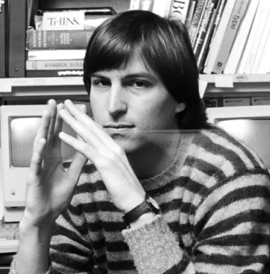
STPA Leadership Seminar
Dr John Thomas
Dr William “Dollar” Young,
"Innovation is the ability to see change as an opportunity, not a threat." - Steve Jobs
STPA: System-Theoretic Process Analysis
© Copyright 2024, John Thomas and William Young

Slide 7
Agenda
Why invest in STPA?
What is STPA?
How does it work?
Who is using it?
  Real world applications & results from others
STPA compared to other methods
STPA: System-Theoretic Process Analysis

Slide 8
Bottom Line Up Front (BLUF)
Many others in our industry have started to use or require STPA to ensure safety / security
  Industry presentations: http://psas.scripts.mit.edu/home/mit-stamp-workshop-presentations/
  Reports and Publications: http://psas.scripts.mit.edu/home/publications/
Why: STPA adds value by examining interactions between currently silo-ed processes (operations, human factors, safety, security, requirements, and conceptual design). STPA identifies weak or missing controls early when they can be mitigated more easily and at the lowest possible cost.
  Especially relevant to the Nuclear Surety, Security, and Safety communities
How: STPA works by modeling the overall system and its operational context in a new way that readily identifies complex interactions and unintended behaviors that lead to unacceptable loses. These results can be modeled using MBSE tools. The process identifies necessary mitigations and architectural features earlier than is done today.
Result: A reduction of rework and cost due to IPTs and stakeholders thoroughly understanding interactions, gaps, and overlaps between disparate systems within the entire WS.
STPA Reduces Cost by Reducing Rework
STPA: System-Theoretic Process Analysis

Slide 9
Value Proposition
WHY

Slide 10
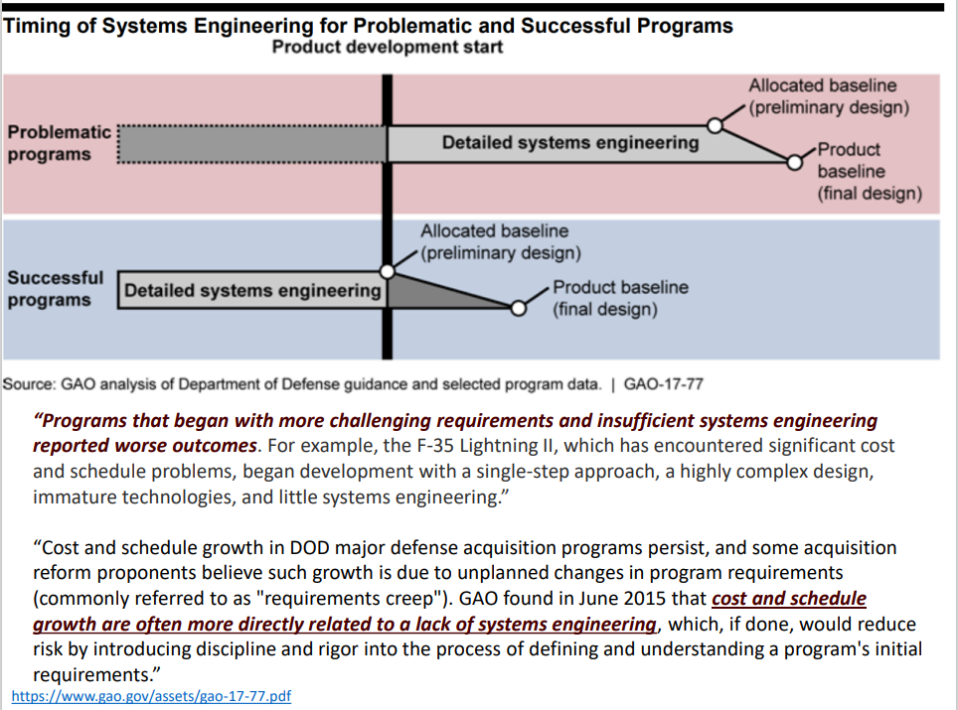
Key finding: The biggest factor driving cost overruns is lack of rigorous system engineering processes (like STPA)

Slide 11
The Hidden Cost of Defects
 | Requirements | Design | Code | Test | Integration
When are defects introduced? | 35% | 35% | 20% | 8% | 2%
When are defects found? | 1% | 2% | 17% | 46% | 34%
Cost to correct | .03% | .3% | 2% | 35% | 62%
STPA identifies and prevents errors earlier, when
the fixes are least expensive (and most effective!)
Data from “ROI Analysis of the System Architecture Virtual Integration Initiative”, SEI, 2018

Slide 12
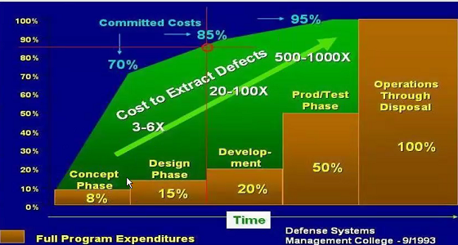
Cost Expenditure Over System Development Lifecycle
STPA is used to uncover the hidden defects
that otherwise require 10-1000x cost to fix
Defense Systems Management College

Slide 13
Software Engineering Economics
Barry Boehm famous study¹ of completed software projects
Large corporations such as IBM, TRW
Flawed assumptions around requirements
Phase in Which Error is Found | Cost Ratio
Requirements | 1
Design | 3-6
Coding | 10
Development Testing | 15-40
Acceptance Testing | 30-70
Operation | 40-1000
“Billions of Dollars are Squandered Each Year Building Products that Don’t Meet Requirements, Mostly Because the Requirements were Never Clearly Understood”
Exploring Requirements, Quality Before Design by Gause & Weinberg
1. Barry Boehm, Software Engineering Economics, 1981

Slide 14
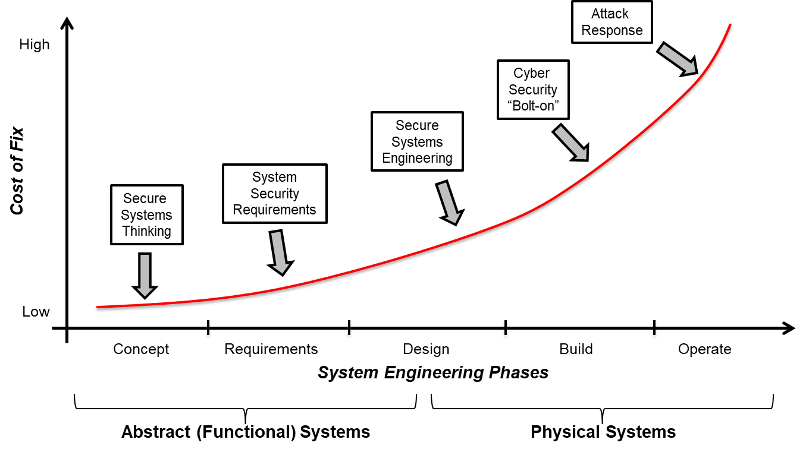
Most Common Causes of Losses in Complex, Software Intensive Systems
Missing Requirements
Flawed Requirements
Flawed Logic
Conflicting Goals
Poor Assumptions
Solving the Wrong Problem
Requirements Flaws Can Be Addressed By Applying Security Engineering Principles During the Concept Phase

Slide 15
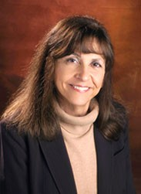
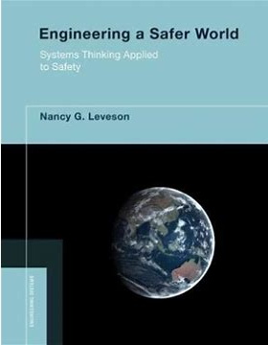
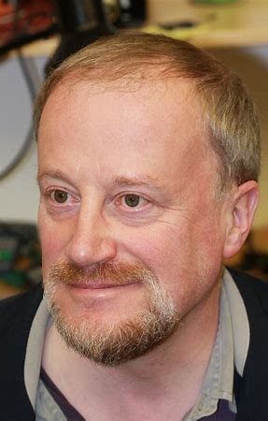
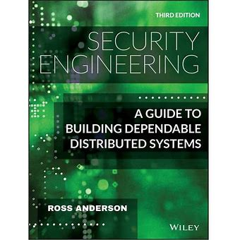
Achieving System Safety and Security Requires Solving the Requirements Problem
Safety
Security
“The vast majority of losses in complex, software-intensive systems can be traced to requirements errors” – Nancy Leveson
“Many systems fail because their designers protect the wrong things, or protect the right things in the wrong way” – Ross Anderson

Slide 16
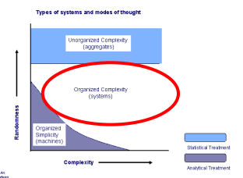
Some Problems Are Not Quantifiable with Probabilities
Examples that violate best practices:
Probability that a requirement is flawed
Probability that a critical function was missed
Probability that a function as designed is not resilient
Probability of design errors or omissions
Probability that a critical assumption was not captured
Probability that an architecture is unsuitable
There is industry consensus about when probability arguments may be used
When probability is not allowed, alternatives are required
Ref: (Weinberg, An Introduction to General Systems Thinking, 1995)

Slide 17
Limitations of Probability Theory:
Industry Consensus
“Development or design errors (whether in the system, software, or hardware) are not the same as hardware failures. Unlike hardware failures, probabilities of such errors cannot be quantified. Therefore, numerical and categorical probabilities should not be indicated for potential errors in fault trees. Any analysis of these potential errors in an FTA should be expressed in terms of development assurance to protect against errors. The analysis should be evaluated on a purely qualitative basis.”
  ARP4761A p27: Guidelines and Methods for Conducting the Safety Assessment Process on Civil Airborne Systems and Equipment
© Copyright 2023 John Thomas

Slide 18
Limitations of Probability:
Industry Consensus
“Assigning a quantitative mishap probability to a potential design or procedural hazard is generally not possible early in the design process.”
  MIL-STD-882E, A.4.4.3.2.2 p27
“The Software Risk Index Matrix does not consider the likelihood of a software-caused hazard occurring in its initial assessment. However, through the successful implementation of a software safety integrity process, the likelihood of software contributing to a hazard occurrence is greatly reduced.
  MIL-STD-882E, A.4.4.3.2.5.2.3 p31
That’s why the standards support qualitative analyses for software (NOT quantitative). The problem is very different!
© Copyright 2023 John Thomas

Slide 19
Limitations of Probability:
Industry Consensus
“The quantitative analyses only address random failures of hardware. These are not applicable to systematic failures.”
  ISO 26262-9:2018 8.2 p13 Road vehicles — Functional safety
© Copyright 2023 John Thomas

Slide 20
A Better Model of
Accidents & Losses
WHAT
A New Model to Explain (and PREVENT) Losses in Complex, Software Intensive Systems

Slide 21
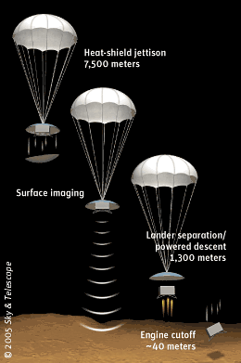
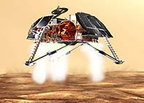
Example: Mars Polar Lander
  During descent to Mars, legs deployed (as planned)
  Footpad sensors detected vibration (within design spec)
  Momentary signal sent to computer (as required)
  Computer shut down the descent engines (as specified)
  The vehicle free-fell, fell to surface at 50 mph (80 kph), destroyed
(John Thomas, 2019; jthomas4@mit.edu)
© Copyright John Thomas 2019

Slide 22
Mars Polar Lander
  During descent to Mars, legs deployed (as planned)
  Footpad sensors detected vibration (within design spec)
  Momentary signal sent to computer (as required)
  Computer shut down the descent engines (as specified)
  The vehicle free-fell, fell to surface at 50 mph (80 kph), destroyed
All components performed exactly as designed!
No single component failed!
(John Thomas, 2019; jthomas4@mit.edu)
© Copyright John Thomas 2019

Slide 23
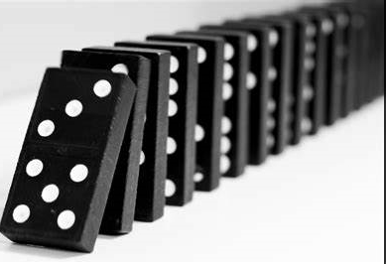
What is done today: Failure Models
  Example:
  One leg may fail. p = 10⁻⁵
  3x footpad sensors may fail
  positive. p = 10⁻⁹
    fail = T signal without vibration
  2x busses may fail. p = 10⁻⁷
  2x computers may fail. p = 10⁻⁶
p(MPL fails) = f(probability X fails, probability Y fails, ..)
1960s Accident Model:
Accidents are a sequence of dominoes
Each failure event is a domino with a probability
© Copyright John Thomas 2019

Slide 24
Mars Polar Lander
  During descent to Mars, legs deployed (as planned)
  Footpad sensors detected vibration (within design spec)
  Momentary signal sent to computer (as required)
  Computer shut down the descent engines (as specified)
  The vehicle free-fell, fell to surface at 50 mph (80 kph), destroyed
Before crash: Probability of mission loss appears LOW
After crash: Mission loss had been virtually guaranteed!
(John Thomas, 2019; jthomas4@mit.edu)
© Copyright John Thomas 2019

Slide 25
MPL: How was this overlooked?
Assessed SW failures.
But SW worked as designed!
Accident behavior did not match any defined SW component failure behaviors.
Assessed HW failures.
But HW worked as designed!
Accident behavior did not match any defined HW component failure behaviors.
SW Design
HW
Design
Operation
New, unplanned interaction emerged among whole system of components!
Assessed operation sequence failures.
But operation sequence matched design intent!
Accident sequence did not match any defined sequence failure.
Easy to overlook the system problems by looking at individual components
John Thomas, 2019
© Copyright 2023 John Thomas

Slide 26
Failure vs. Error: Two Different Causes of Losses
 | Failure Definition | Error Definition
ISO 26262-2011: Functional Safety | Termination of the ability of an element or an item to perform a function as required | Discrepancy between a computed, observed or measured value or condition and the true, specified, or theoretically correct value or condition
ISO 26262-2018: Functional Safety | Termination of an intended behavior of an element or an item due to a fault activation | Discrepancy between a computed, observed or measured value or condition and the true, specified, or theoretically correct value or condition
ISO/PAS 21448: SOTIF | [Not Defined] | [Not Defined]
ARP 4754A/B | An occurrence which affects the operation of a component, part or element such that it can no longer function as intended, (this includes both loss of function and malfunction). | An omitted or incorrect action by a crewmember or maintenance person, or a mistake in requirements, design, or implementation
ARP 4761 | A loss of function or malfunction of a system or a part thereof. | (1) An occurrence arising as a result of an incorrect action or decision by personnel operating or maintaining a system (JAA AMJ 25.1309) (2) A mistake in specification, design, or implementation
ARP 4761A | An occurrence which affects the operation of a component, part, or element such that it can no longer function as intended (this includes both loss of function and malfunction). | An omitted or incorrect action by a manufacturer, crew member, or maintenance person, or a mistake in requirements, design, or implementation (derived from AMC 25.1309)
IEC 61000 / 61508 | Termination of the ability of an item to perform a required function | Discrepancy between a computed, observed or measured value or condition and the true, specified or theoretically correct value or condition
IEEE 100-2000: IEEE Authoritative Dictionary of IEEE Standards Terms | The termination of the ability of an item to perform a required function | - Any incorrect step, process, or result. Note: In the computer field the term commonly is used to refer to a machine malfunction as a machine error (or computer error) and to a human mistake as a human error (or operator error). Frequently it is helpful to distinguish between these errors as follows; an error results from incorrect programming, coding, data transcription, manual operation, etc., a malfunction results from a failure in the operation of a machine component such as a gate, a flip-flop, or an amplifier - (software reliability) Human action that results in software containing a fault. Examples include omission or misinterpretation of user requirements in a software specification, incorrect translation, or omission of a requirement in the design specification.

Slide 27
Failure vs. Error: When is quantification allowed?
Failure: Generally, when a component doesn’t do what we told it (designed it) to do.
Error: Generally, when a component does what we told it (designed it) to do.
May be Quantified
May NOT be Quantified
© Copyright 2023 John Thomas

Slide 28
Failure vs. Error: Trend over time
Failure: Generally, when a component doesn’t do what we told it (designed it) to do.
Error: Generally, when a component does what we told it (designed it) to do.
Often causes major losses in older systems
Often causes major losses in newer systems
© Copyright 2023 John Thomas

Slide 29
Failure vs. Error: Strength of our processes
Failure: Generally, when a component doesn’t do what we told it (designed it) to do.
Error: Generally, when a component does what we told it (designed it) to do.
We have strong processes here
We do not have strong processes here
© Copyright 2023 John Thomas

Slide 30
STAMP / STPA: A Control Loop Perspective
Controllers can be human operators, software, AI/ML, human engineers, managers, etc.
Control actions are provided to affect a controlled process
Feedback may be used to monitor the process
Process model (beliefs) formed based on feedback and other information
Decision Making determines appropriate control actions given current beliefs
Controller
Decision Making
Process
Model
Control
Actions
Feedback
Controlled Process
(Leveson, 2012)

Slide 31
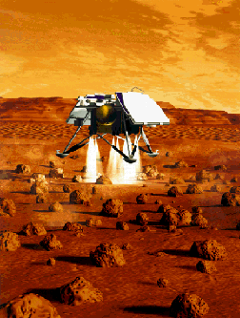
A different View (Model) for Loss Prevention
Controller
Decision Making
Process
Model (beliefs)
Control
Actions
Feedback
Controlled Process
A systems view (not failure-based view) of safety
A systems view (not threat-based view) of security
Forms foundation for STAMP/STPA/CAST/STPA-SEC
(John Thomas, 2011; jthomas4@mit.edu)
© Copyright John Thomas 2019

Slide 32
Basic Control Loop
Loss: Lander crashes
Incorrectly believes spacecraft is on ground
Thruster Computer
Decision Making
Process
Model (beliefs)
Touchdown indication received when in air
HCA: Computer provides Disable-Thruster cmd when spacecraft is in the air
Control
Actions
Feedback
Leg deployment vibration triggers hall-effect sensors
Controlled Process
This control loop provides a different perspective. STPA is the step-by-step method to consistently find and prevent these scenarios
(John Thomas, 2019; jthomas4@mit.edu)
© Copyright John Thomas 2019

Slide 33
Principles from Control Theory
Four conditions required to effect control over a system:
Goal Condition: The controller must have a goal or
goals (e.g., to maintain a setpoint)
Action Condition: The controller must be able to
affect the system state
Observability Condition: The controller must be
able to ascertain the state of the system.
Model Condition: The controller must have (or contain)
a model of the system
Ashby, 1957
© Copyright 2023 John Thomas

Slide 34
Principles from Control Theory
Four conditions required to effect control over a system:
Goal Condition: The controller must have a goal or
goals (e.g., to maintain a setpoint)
Action Condition: The controller must be able to
affect the system state
Observability Condition: The controller must be
able to ascertain the state of the system.
Model Condition: The controller must have
(or contain) a model of the system
Potential targets for an adversary!
Ashby, 1957
© Copyright 2023 John Thomas

Slide 35
Goal Condition: The controller must have suitable goals (e.g., to maintain a setpoint)
Controller
Decision Making
Process
Model
Control
Actions
Feedback
Controlled Process
(Leveson, 2012)
© Copyright 2023 John Thomas

Slide 36
Observability Condition: The controller must be able to ascertain the relevant states of the system.
Controller
Decision Making
Process
Model
Control
Actions
Feedback
Controlled Process
(Leveson, 2012)
© Copyright 2023 John Thomas

Slide 37
Model Condition: The controller must have (or contain) a model of the system
Controller
Decision Making
Process
Model
Control
Actions
Feedback
Controlled Process
(Leveson, 2012)
© Copyright 2023 John Thomas

Slide 38
Action Condition: The controller must be able to affect the system state
Controller
Decision Making
Process
Model
Control
Actions
Feedback
Controlled Process
(Leveson, 2012)
© Copyright 2023 John Thomas

Slide 39
Goal Condition: The controller must have and prioritize appropriate goals
Model Condition: The controller must have a model of the system state and how it can change
Controller
Decision Making
Process
Model
Control
Actions
Feedback
Controlled Process
Observability Condition: The controller must be able to ascertain the state of the system.
Action Condition: The controller must have appropriate authority and control to achieve the goals
© Copyright 2023 John Thomas

Slide 40
Model Condition:
Goal Condition:
Controller
Decision Making
Process
Model
Control
Actions
Feedback
Controlled Process
Observability Condition:
Action Condition
Accidents & incidents events occur because these conditions were broken!
© Copyright 2023 John Thomas

Slide 41
Controller
Decision Making
Process
Model
Hazardous Control Actions (HCAs)
Control Actions may be Hazardous in 4 ways:
  Control actions required for safety (security) are not given
  Unsafe (insecure) actions are given
  Potentially safe (secure) control actions but given too early, too late (timing)
  Control action stops too soon or applied too long (duration)
Control
Actions
Feedback
Controlled Process
(Leveson, 2012)
© Copyright 2023 John Thomas

Slide 42
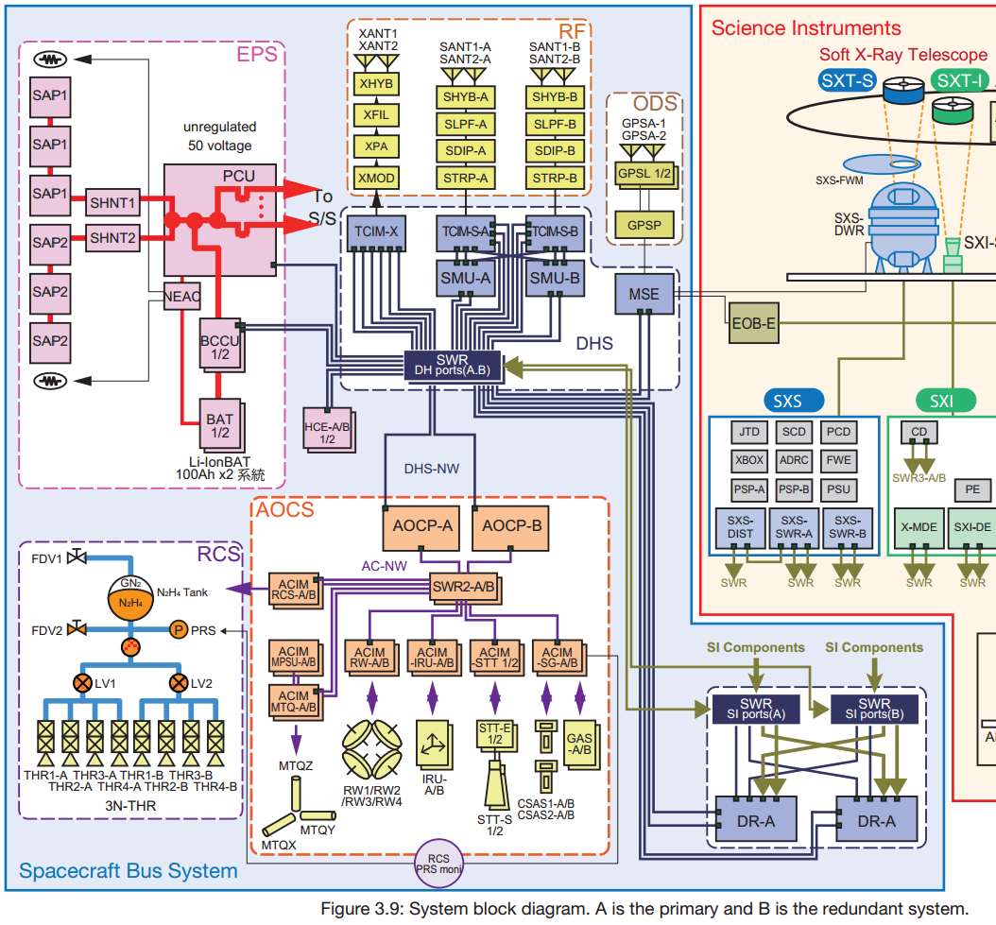
Enabling abstraction
Automated Controllers
Control
Navigation Controller
Attitude Controller
Physical processes
Thomas, 2017
© Copyright 2018 John Thomas

Slide 43
Enabling abstraction
Control
Operators
Automated Controllers
Other processes
Physical processes
Thomas, 2017
© Copyright 2023 John Thomas

Slide 44
Enabling abstraction
Operations Management
Control
Operators
Automated Controllers
Other processes
Physical processes
Component view
Systems view (STPA)
Thomas, 2017
© Copyright 2023 John Thomas

Slide 45
Some Factors in Causal Scenarios
Control input or external information wrong or missing
^{Controller}
Missing or wrong communication with another controller
^{Controller}
Inadequate Decision Making (Flaws in creation, process changes, incorrect modification or adaptation)
^{Process Model}
(inconsistent, incomplete, or incorrect)
Inappropriate, ineffective, or missing control action
^{Inadequate or missing feedback}
^{Feedback Delays}
^{Actuator}
^{Sensor}
^{Inadequate operation}
^{Inadequate operation}
^{Delayed operation}
Incorrect or no information provided
^{Measurement inaccuracies}
^{Feedback delays}
^{Controller}
^{Controlled Process}
^{Component failures/errors}
^{Unsafe states and}
^{non-failures}
^{Changes over time}
^{Conflicting control actions}
Process output contributes to system hazard
^{Process input missing or wrong}
Unidentified or out-of-range disturbance
Note: This is not intended to be complete, but it provides a starting point. You will need to tailor the specific factors relevant to your application.
(Leveson, 2012)
Notes:
45

Slide 46
Some Factors in Causal Scenarios
Control input or external information wrong or missing
^{Controller}
Missing or wrong communication with another controller
^{Controller}
^{Inadequate Decision Making}
(Flaws in creation, process changes, incorrect modification or adaptation)
^{Process Model}
(inconsistent, incomplete, or incorrect)
Inappropriate, ineffective, or missing control action
^{Inadequate or missing feedback}
^{Feedback Delays}
^{Actuator}
^{Sensor}
^{Inadequate operation}
^{Inadequate operation}
^{Delayed operation}
Incorrect or no information provided
^{Measurement inaccuracies}
^{Feedback delays}
^{Controller}
^{Controlled Process}
^{Component failures/errors}
^{Unsafe states and}
^{non-failures}
^{Changes over time}
Potential targets for an adversary?
^{Conflicting control actions}
Process output contributes to system hazard
^{Process input missing or wrong}
Unidentified or out-of-range disturbance
Note: This is not intended to be complete, but it provides a starting point. You will need to tailor the specific factors relevant to your application.
(Leveson, 2012)
Notes:
46

Slide 47
Some Factors in Causal Scenarios
Control input or external information wrong or missing
^{Controller}
Missing or wrong communication with another controller
^{Controller}
^{Inadequate Decision Making}
(Flaws in creation, process changes, incorrect modification or adaptation)
^{Process Model}
(inconsistent, incomplete, or incorrect)
Inappropriate, ineffective, or missing control action
^{Inadequate or missing feedback}
^{Feedback Delays}
^{Actuator}
^{Sensor}
^{Inadequate operation}
^{Inadequate operation}
^{Delayed operation}
Incorrect or no information provided
^{Measurement inaccuracies}
^{Feedback delays}
^{Controller}
^{Controlled Process}
^{Component failures/errors}
^{Changes over time}
^{Conflicting control actions}
Process output contributes to system hazard
^{Process input missing or wrong}
Unidentified or out-of-range disturbance
(Leveson, 2012)
Notes:
47

Slide 48
Some Factors in Causal Scenarios
Control input or external information wrong or missing
^{Controller}
Missing or wrong communication with another controller
^{Controller}
^{Inadequate Decision Making}
(Flaws in creation, process changes, incorrect modification or adaptation)
^{Process Model}
(inconsistent, incomplete, or incorrect)
Inappropriate, ineffective, or missing control action
^{Inadequate or missing feedback}
^{Feedback Delays}
^{Actuator}
^{Sensor}
^{Inadequate operation}
^{Inadequate operation}
^{Delayed operation}
Incorrect or no information provided
^{Measurement inaccuracies}
^{Feedback delays}
^{Controller}
^{Controlled Process}
^{Component failures/errors}
^{Changes over time}
^{Conflicting control actions}
Potential targets for an adversary?
Process output contributes to system hazard
^{Process input missing or wrong}
Unidentified or out-of-range disturbance
(Leveson, 2012)
Notes:
48

Slide 49
Some Factors in Causal Scenarios
Control input or external information wrong or missing or malformed
Missing, wrong, or unauthorized communication with another controller
^{(Malicious) Controller}
^{Controller}
^{Inadequate Decision Making}
(Flaws in creation, process changes, incorrect modification or adaptation)
^{Process Model}
(inconsistent, incomplete, or incorrect)
Inappropriate, ineffective, malformed, or missing control action
Inadequate, malformed, or missing feedback
^{Feedback Delays}
^{Actuator}
^{Sensor}
^{Inadequate operation}
^{Inadequate operation}
Delayed, partial, or malformed operation
Incorrect, partial, or no information provided
^{Measurement inaccuracies}
^{Feedback delays}
^{(Malicious) Controller}
^{Controlled Process}
^{Component failures/errors}
^{Changes over time}
^{Conflicting control actions}
Potential targets for an adversary!
Process output contributes to system hazard
^{Process input missing or wrong}
Unidentified or out-of-range disturbance
(Young, 2014)
Notes:
49

Slide 50
MPL: Why didn’t software testing uncover the problem?
Software tests were based on software requirements
Touchdown sensor tests were based on hardware requirements
System-level tests in vacuum/thermal chamber did not uncover problem
Exhaustive testing isn’t possible on modern systems (e.g., 10⁴⁰ states).
How do we choose what to test? Testing is usually based on the requirements.
If the requirements are missed, it’s easy to miss in testing.
(John Thomas, 2019; jthomas4@mit.edu)
© Copyright John Thomas 2019

Slide 51




Basic Control Structure (Security Perspective)
Operators
Controller
Security Policy
Reference Monitor
Control
Security Architecture
Enforcement Actions
Feedback
Other processes
Protected Process
Physical
processes

Slide 52
System Security with System-Theoretic Process Analysis for Security (STPA-Sec)
STPA-Sec
Problem framing
Identify accidents and hazards
Draw the functional control structure
Identify unsafe/unsecure control actions
Identify security-related causal scenarios
Wargame
STPA Hazard Analysis
Controller
Control
Actions
Feedback
STAMP Model
Controlled
process
* Security Extension to STPA

Slide 53
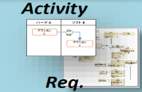
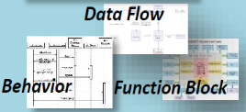
Model-Based Systems Engineering (MBSE) is the Foundation for Current Early System Development
Breakdown the design
Model Based
Systems Engineering
Approach
System Req. Model
Mission Design (MDR/SRR)
Design Model
Concept Design (SDR)
V&V
Design Model
Preliminary Design (PDR)
V&V
Design Model
Critical Design (CDR)
V&V
Ref: Adapted From Thomas: “A Process for STPA: STAMP Accident Model of Hitomi and Expansion to Future Safety Culture”

Slide 54
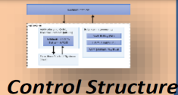
STPA-Sec Adds Security and Mission Emphasis to Complement Existing MBSE
Mission Concept / Operational Concept
Breakdown the design
Model Based
Systems Engineering
Approach
System Req. Model
STPA-Sec Approach
Mission Design (MDR/SRR)
Design Model
Security Analysis Model
Concept Design (SDR)
Refine
V&V
Security Review
Design Model
Security Analysis Model
Preliminary Design (PDR)
Refine
V&V
Security Review
Design Model
Security Analysis Model
Critical Design (CDR)
Refine
V&V
Security Review
Data Framework
Ref: Adapted From Thomas: “A Process for STPA: STAMP Accident Model of Hitomi and Expansion to Future Safety Culture”

Slide 55
STPA-Sec Adds Security and Mission Analysis to Complement Existing MBSE
Mission Concept / Operational Concept
Breakdown the design
Model Based
Systems Engineering
Approach
System Req. Model
STPA-Sec Approach
Mission Design (MDR/SRR)
PHYSICAL FORM
ABSTRACT FUNCTION
Design Model
Security Analysis Model
Concept Design (SDR)
Refine
V&V
Security Review
Design Model
Security Analysis Model
Preliminary Design (PDR)
Refine
V&V
Security Review
Design Model
Security Analysis Model
Critical Design (CDR)
Refine
V&V
Security Review
Data Framework
Ref: Adapted From Thomas: “A Process for STPA: STAMP Accident Model of Hitomi and Expansion to Future Safety Culture”

Slide 56
STPA Overview
HOW

Slide 57
STPA
1) Define Purpose of the Analysis
2) Model the Control Structure
3) Identify Hazardous Control Actions
4) Identify Loss Scenarios
Identify Goals, Losses, Hazards
Define System boundary
Environment
System
How could behavior occur
Losses to prevent
Model
Behavior to prevent
(Leveson and Thomas, 2018)

Slide 58
STPA
STPA
1) Define Purpose of the Analysis
2) Model the Control Structure
3) Identify Hazardous Control Actions
4) Identify Loss Scenarios
Identify Goals, Losses, Hazards
Define System boundary
Environment
System
(Leveson and Thomas, 2018)

Slide 59
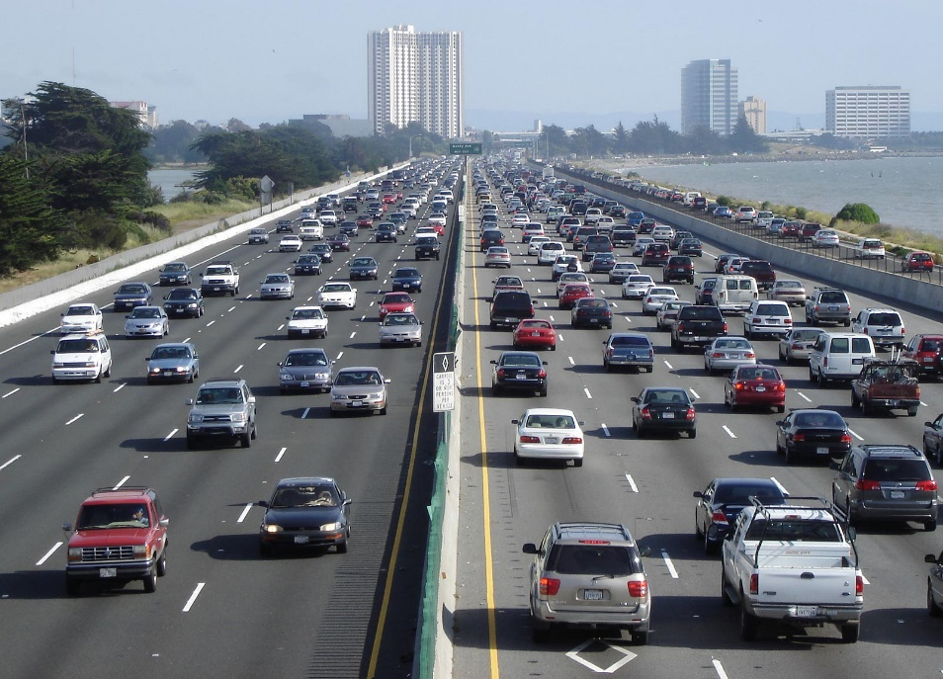
Concept: Automotive Vehicle
Goal: To ______
What (System): A ____
How (Method): By means of ___
Adapted from Young, 2014

Slide 60
Concept: Automotive Vehicle
Goal: To transport people from A to B
  Is this the right goal? Consider other goals.
What (System): A bus
  Is this the right type of system? Consider other potential systems.
How (Method): By means of carrying people on roadways from start point A to end point B
  Is this the best method to achieve the goal? Consider other methods.
Adapted from Young, 2014

Slide 61
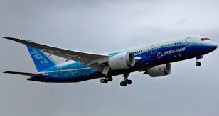
Aviation Example
Stakeholder Losses to prevent
  L-1. Loss of life or serious injury to people
  L-2. Damage to the aircraft or objects outside the aircraft
  L-3: Loss of mission (transportation)
  L-4: Loss of performance / efficiency
© Copyright 2023 John Thomas

Slide 62
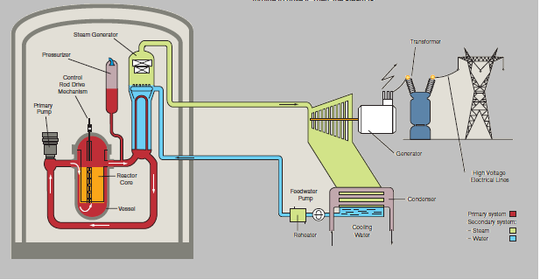
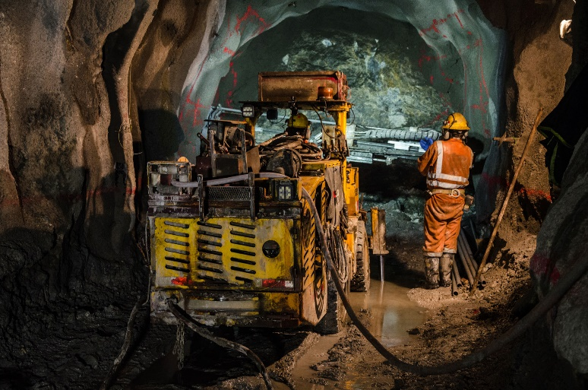
What is “Safety”?
Losses
L-1: Loss of life or injury
L-2: Environmental damage
L-3: Loss of production
L-4: Equipment damage
Safety means preventing all losses
(Thomas, 2014)
© Copyright 2023 John Thomas

Slide 63

STPA
1) Define Purpose of the Analysis
2) Model the Control Structure
3) Identify Hazardous Control Actions
4) Identify Loss Scenarios
Identify Goals, Losses, Hazards
Define System boundary
Environment
System
(Leveson and Thomas, 2018)

Slide 64
Control structure
Operations Management
Humans
Human Operator
Humans
Control, Authority
Automation
Automated Controllers
Physical
Physical processes
John Thomas, 2019
© Copyright 2023 John Thomas

Slide 65
Control structure
Operations Management
Human Management
Control, Authority
Human Operator
Human Workers
Automated Controllers
Automation
Physical
Physical processes
John Thomas, 2019
© Copyright 2023 John Thomas

Slide 66
Control structure
Operations Management
Controllers
(Decision-makers)
Human Operator
Controlled Processes
Automated Controllers
Physical processes
John Thomas, 2019
© Copyright 2023 John Thomas

Slide 67
Control structure
Operations Management
Control Actions
(possible actions by controllers)
Feedback
(possible indications to inform controller decisions)
Human Operator
Downward Arrows
Automated Controllers
Upward Arrows
Physical processes
Control Actions
Feedback
John Thomas, 2019
© Copyright 2023 John Thomas

Slide 68
Control structure
Operations Management
Procedures
Reporting
Human Operator
ESS On / Off
ESS State (on/off)
Accelerate
Brake Steer
Shift
Automated Controllers
Engine Start
Engine RPM
Physical processes
Control Actions
Feedback
John Thomas, 2019
© Copyright 2023 John Thomas

Slide 69
Control structure
Operations Management
Process Model (beliefs)
Human Operator
Process Model (beliefs)
Automated Controllers
Process Model (beliefs)
Physical processes
John Thomas, 2019
© Copyright 2023 John Thomas

Slide 70
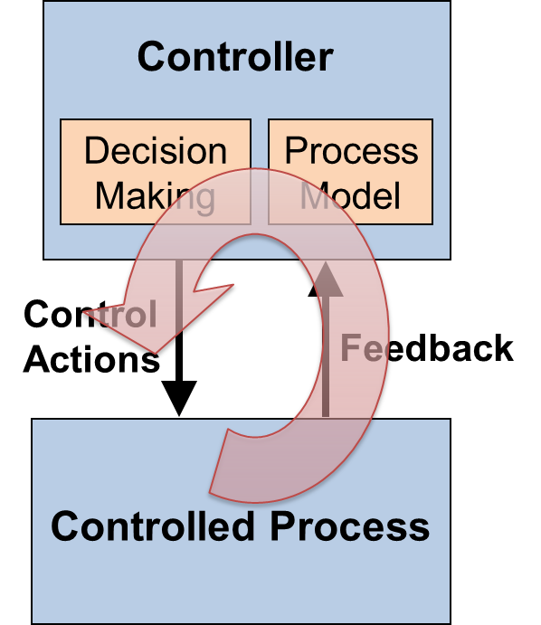
Control structure
Operations Management
Process Model (beliefs)
Human Operator
Process Model (beliefs)
Automated Controllers
Process Model (beliefs)
Physical processes
John Thomas, 2019
© Copyright 2023 John Thomas

Slide 71
Control structure
Operations Management
Human Operator
Automated Controllers
Physical processes
John Thomas, 2019
© Copyright 2023 John Thomas

Slide 72
Basic control loop
Control actions are provided to affect a controlled process
Feedback may be used to monitor the process
Process model (beliefs) formed based on feedback and other information
Decision making determines appropriate control actions given current beliefs
Controller
Decision Making
Process
Model
Control
Actions
Feedback
Controlled Process
John Thomas, 2019
© Copyright 2023 John Thomas

Slide 73
Control structure
Operations Management
Human Operator
Automated Controllers
Physical processes
John Thomas, 2019
© Copyright 2023 John Thomas

Slide 74
Control structure
Operations Management
Human Operator
Automated Controllers
Physical processes
John Thomas, 2019
© Copyright 2023 John Thomas

Slide 75
Control structure
Operations Management
Human Operator
Automated Controllers
Physical processes
John Thomas, 2019
© Copyright 2023 John Thomas

Slide 76
Human Operator
Control, Authority
“Zooming in” to create more detailed control structure
Automated Controllers
Physical processes
John Thomas, 2019
© Copyright 2023 John Thomas

Slide 77
Human Operator
Control, Authority
“Zooming in” to create more detailed control structure
Automated Controllers
Physical processes
John Thomas, 2019
© Copyright 2023 John Thomas

Slide 78
STPA
1) Define Purpose of the Analysis
2) Model the Control Structure
3) Identify Hazardous Control Actions
4) Identify Loss Scenarios
Identify Losses, Hazards
Define System boundary
Environment
System
(Leveson and Thomas, 2018)

Slide 79
STPA: Identify Hazardous Control Actions (HCA)
Human Operators
Automated Controllers
 | Not provided causes hazard | Providing causes hazard | Too early, too late, out of order | Stopped too soon, applied too long
Cmd Y
Physical processes
(Thomas, 2017)
© Copyright 2023 John Thomas

Slide 80
STPA HCA Bounding
Providing HCAs (excessive, etc.)
Control Action provided
Providing HCAs (wrong sit., etc.)
Too Early HCAs
Applied Too Long HCAs
Providing HCAs (insuff., etc.)
Too Late HCAs
Stopped Too Soon HCAs
Control Action not provided
Not Provided HCAs
time
A safe control action necessary to prevent hazards
Slightly early, but safe
Too early, unsafe
Control Actions | Not providing causes hazard | Providing causes hazard [in wrong situation, excessive, insufficient, repetitive, wrong direction, etc.] | Too early, too late, Order | Stopped Too Soon / Applied too long
Control Actions: Throttle Engine Shutdown | ? | ? | ? | ?
The complete set of HCAs will fully bound the necessary safe behavior
© Copyright John Thomas 2023

Slide 81
STPA: Identify Hazardous Control Actions (HCA)
Human Operators
 | Not provided causes hazard | Providing causes hazard | Too early, too late, out of order | Stopped too soon, applied too long
Automated Controllers
X
Example HCA:
Controller X
does not provide
Cmd Y
when Z
[H-1]
Cmd Y
Physical processes
(Thomas, 2017)
© Copyright 2023 John Thomas

Slide 82
STPA: Identify Hazardous Control Actions (HCA)
Human Operators
 | Not provided causes hazard | Providing causes hazard | Too early, too late, out of order | Stopped too soon, applied too long
Automated Controllers
X
Example HCA:
Controller X
does not provide
Cmd Y
when Z
[H-1]
HCA Syntax:
Source Cont.
HCA Type
Control Action
Context
Traceability
Cmd Y
Physical processes
(Thomas, 2017)
© Copyright 2023 John Thomas

Slide 83
STPA: Identify Hazardous Control Actions (HCA)
Human Operators
 | Not provided causes hazard | Providing causes hazard | Too early, too late, out of order | Stopped too soon, applied too long
Automated Controllers
X
Example HCA:
Controller X
provides
Cmd Y
when Z
Cmd Y
Physical processes
(Thomas, 2017)
© Copyright 2023 John Thomas

Slide 84
STPA: Identify Hazardous Control Actions (HCA)
Human Operators
 | Not provided causes hazard | Providing causes hazard | Too early, too late, out of order | Stopped too soon, applied too long
Automated Controllers
X
Cmd Y
Example HCA:
Controller X
provides
Cmd Y
when Z
HCA Syntax:
Source Controller
HCA Type
Control Action
Context
Physical processes
(Thomas, 2017)
© Copyright 2023 John Thomas

Slide 85
Generating constraints and requirements
High-level safety constraints
Controller X should not allow A
Controller X shall enforce B
Etc.
 | Not provided causes hazard | Providing causes hazard | Too early, too late, out of order | Stopped too soon, applied too long
Cmd
Controller X shall provide CMD Y when D | Controller X should not provide CMD Y when E | Controller X shall provide CMD Y within F seconds of G | Controller X shall stop providing CMD Y within H seconds of J
Controller functional safety requirements
(Thomas, 2017)
© Copyright 2023 John Thomas

Slide 86
Generating requirements and constraints
High-level responsibilities
Controller X will need to collect information from components Y, Z
Controller X will need to detect A and respond with B
Etc.
 | Not provided causes hazard | Providing causes hazard | Too early, too late, out of order | Stopped too soon, applied too long
Cmd
Controller X shall provide CMD when D | Controller X should not provide CMD when E | Controller X shall provide CMD within Y seconds of F | Controller X shall stop providing CMD within Z seconds of G
Controller functional safety requirements
AC 23.1309-1E: “It is necessary to consider the possibility of requirement, design, and implementation errors in order to comply with the requirements of
§ 23.1309.”
STPA can identify these errors so they can be fixed
(Thomas, 2017)
© Copyright 2023 John Thomas

Slide 87
What about human interactions?

Slide 88
Hazardous Control Actions (HCA)
Flight Crew
 | Not provided causes hazard | Providing causes hazard | Too early, too late, out of order | Stopped too soon, applied too long
Cmd Y
Automated Controllers
High-level responsibilities
Crew will need to detect A and respond with B
Crew will need information about C, D
Etc.
Physical processes
(Thomas, 2017)
© Copyright 2023 John Thomas

Slide 89
Hazardous Control Actions (HCA)
Flight Crew
 | Not provided causes hazard | Providing causes hazard | Too early, too late, out of order | Stopped too soon, applied too long
Cmd Y
Automated Controllers
14 CFR 25.1329: System “must be designed to minimize flightcrew errors and confusion concerning the behavior and operation”
Crew shall provide CMD Y when D | Crew should not provide CMD Y when E | Crew shall provide CMD Y within F seconds of G | Crew shall stop providing CMD Y within H seconds of J
Crew procedures
STPA can identify the errors and confusion so it can be fixed
(Thomas, 2017)
© Copyright 2023 John Thomas

Slide 90
Hazardous Control Actions (HCA)
Human Operators
 | Not provided causes hazard | Providing causes hazard | Too early, too late, out of order | Stopped too soon, applied too long
Cmd Y
Automated Controllers
Physical processes
(Thomas, 2017)
© Copyright 2023 John Thomas

Slide 91
Generating & validating operator procedures
Human Operators
 | Not provided causes hazard | Providing causes hazard | Too early, too late, out of order | Stopped too soon, applied too long
Cmd Y
Automated Controllers
Operator X shall provide CMD Y when D | Operator X should not provide CMD Y when E | Operator X shall provide CMD Y within F seconds of G | Operator X shall stop providing CMD Y within H seconds of J
Operator procedures
(John Thomas, 2017)
© Copyright 2023 John Thomas

Slide 92
STPA
1) Define Purpose of the Analysis
2) Model the Control Structure
3) Identify Hazardous Control Actions
4) Identify Loss Scenarios
Identify Losses, Hazards
Define System boundary
Environment
System
(Leveson and Thomas, 2018)

Slide 93
STPA
1) Define Purpose of the Analysis
2) Model the Control Structure
3) Identify Hazardous Control Actions
4) Identify Loss Scenarios
Identify Losses, Hazards
Define System boundary
Environment
System
(Leveson and Thomas, 2018)

Slide 94
Identify loss scenarios
Operators
What could cause Hazardous Control Actions?
Automated Controllers
Scenarios
Controller incorrectly believes A because …
Controller decision making does not enforce B because …
Incorrect feedback C received because …
Sensor failure causes…
Etc.
PM
Hazardous Control Actions (HCAs)
Cmd Y
Physical processes
(John Thomas, 2017)
© Copyright 2023 John Thomas

Slide 95
Identify loss scenarios
Operators
Automated Controllers
How could control actions not be executed or followed properly?
Scenarios
Cmd sent but not received because…
Cmd received but ignored because…
Actuator failure causes…
Control Actions
Cmd Y
Physical processes
(Thomas, 2017)
© Copyright 2023 John Thomas

Slide 96
What about human interactions?

Slide 97
Identify loss scenarios
Operators
Process Model
What could cause Hazardous Control Actions?
Hazardous Control Actions (HCAs)
Cmd Y
Scenarios
Op responded to failure in A by …
Op incorrectly believes B because …
Op does not perform C because …
Op received incorrect feedback D because …
Etc.
Automated Controllers
Physical processes
(John Thomas, 2017)
© Copyright 2023 John Thomas

Slide 98
Identify loss scenarios
Operators
How could control actions not be executed or followed properly?
Control Actions
Cmd Y
Scenarios
Op cmd sent but not received because…
Op cmd received but ignored because…
Actuator failure causes…
Automated Controllers
Physical processes
(Thomas, 2017)
© Copyright 2023 John Thomas

Slide 99
Provide Solutions
Solutions
Component A must be able to respond within B seconds to avoid C
Controller X must provide D when E to prevent F
Component G shall automatically operate within H seconds when J
Operator must provide K and L together when M to prevent N (assumption)
Etc.
Scenarios
Rationale and assumptions identified
Every recommendation and requirement is traceable
(Thomas, 2017)
© Copyright 2023 John Thomas

Slide 100
Provide Solutions
Solutions
Design Decisions
Requirements & Constraints
Alternative Control Structure
Responsibilities
Scenarios
Rationale and assumptions identified
Every recommendation and decision is traceable
(Thomas, 2017)
© Copyright 2023 John Thomas

Slide 101
Provide Solutions
Solutions
Design Decisions
Requirements & Constraints
Alternative Control Structure
Responsibilities
Leading Indicators
Audits & Intervention Plans
Test cases
Procedures
Operator Training
Etc.
Scenarios
Rationale and assumptions identified
Every recommendation and decision is traceable
(Thomas, 2017)
© Copyright 2023 John Thomas

Slide 102
STPA Outputs
Loss scenarios
Constraints that need to be enforced
A conceptual architecture that enforces the constraints
The responsibilities that need to be allocated
Assumptions that need to be validated
Behavioral requirements that need to be enforced
Procedures
Critical test scenarios / test cases
Operational leading indicators of risk
Audit plan
Etc.
© Copyright 2023 John Thomas

Slide 103
STPA Overview
STPA
1) Define Purpose of the Analysis
2) Model the Control Structure
3) Identify Hazardous Control Actions
4) Identify Loss Scenarios
Identify Losses, Hazards
Define System boundary
Environment
System
(Leveson and Thomas, 2018)

Slide 104
Using STPA and MBSE
HOW
- Example of Finding a Missing Requirement

Slide 105
STPA Adds Security and Mission Analysis to Complement Existing MBSE
Mission Concept / Operational Concept
Breakdown the design
Model Based
Systems Engineering
Approach
System Req. Model
STPA-Sec Approach
Mission Design (MDR/SRR)
PHYSICAL FORM
ABSTRACT FUNCTION
Concept Design (SDR)
Design Model
Refine
Security Analysis Model
V&V
Security Review
Preliminary Design (PDR)
Design Model
Refine
Security Analysis Model
V&V
Security Review
Critical Design (CDR)
Design Model
Refine
Security Analysis Model
V&V
Security Review
Data Framework
Ref: Adapted From Thomas: “A Process for STPA: STAMP Accident Model of Hitomi and Expansion to Future Safety Culture”

Slide 106
STPA and MBSE
“I already have detailed MBSE models. Is it worth trying STPA?”
Let’s compare:
  Existing generic STPA for a satellite
  Existing generic SysML for a satellite
Does STPA provide any value or insights beyond what is modeled in SysML?

Slide 107
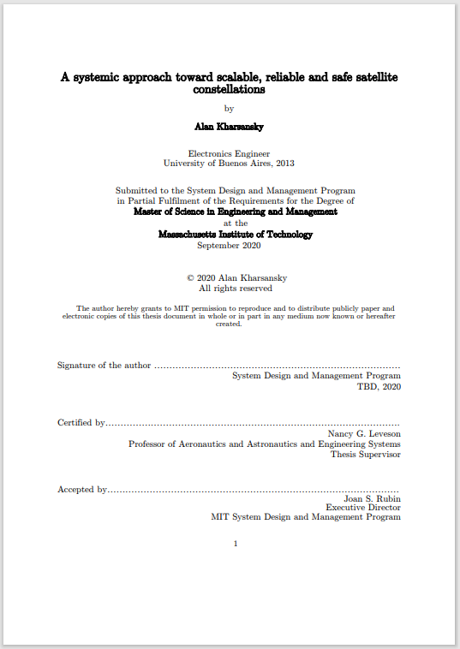
System Theoretic Process Analysis Report & Model
STPA example:
  MIT Masters Thesis
  A Systematic Approach Towards Scalable, Reliable and Safe Satellite Constellations
Provides a single satellite analysis
  Goals
  Losses
  Hazards
  Control Structure
  Hazardous Control Actions
  Scenarios
Thesis Provides a Representative STPA Analysis For a Satellite System

Slide 108
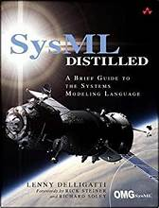
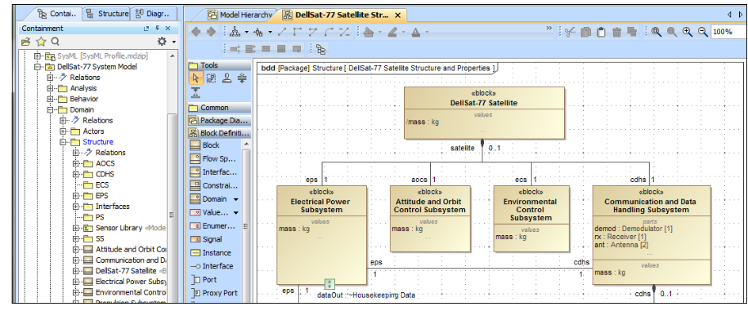
Satellite System Architectural Model and Artifacts
“The sample diagrams in the figures present various aspects of a single system, the DellSat-77 Satellite System—a system I conceived of entirely for the purpose of writing this book (and I hereby certify that I have not disclosed any proprietary information of any aerospace companies). I chose to focus on a satellite system to demonstrate how you can use SysML to model a complex, real-world sociotechnical system”
Used the DellSAT-77 as presented in Dellgatti’s book
SysML models available and used in analysis
Enabled completely unclassified demonstration
Representative satellite system
Representative of some artifacts believed available for operational study (e.g. statecharts)
DellSAT SysML Model & Artifacts Are Representative Architecture
https://ei194.infusionsoft.app/app/page/free-sysml-model?cookieUUID=b2443ee0-99ea-42cc-a132-e829a011d7c7

Slide 109
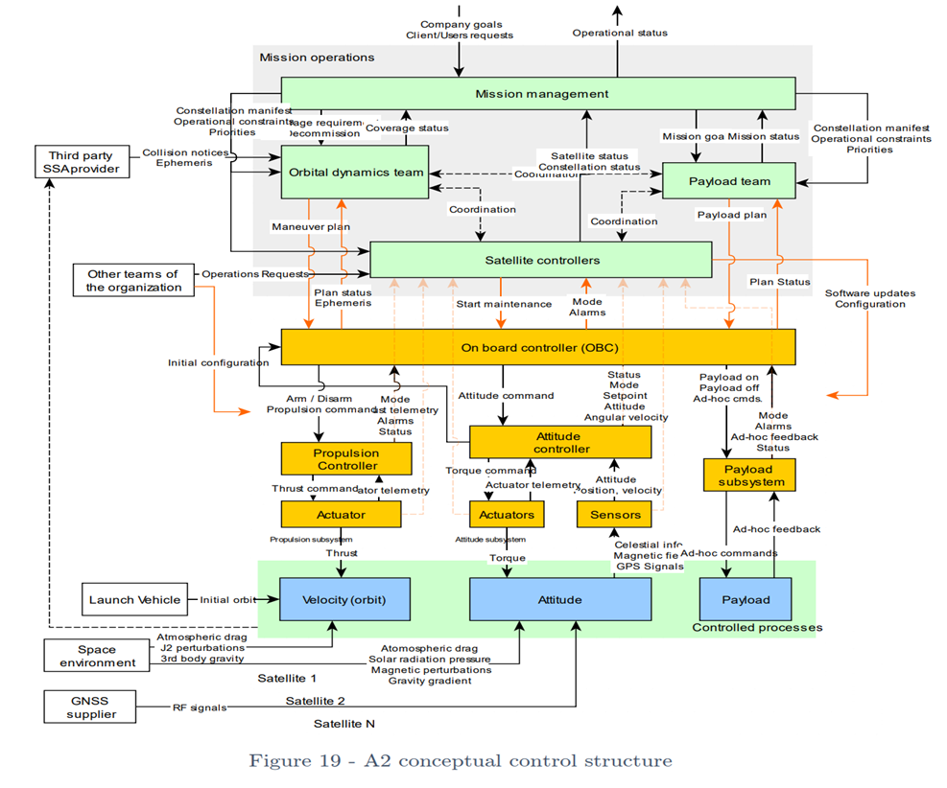
Identify Relevant Portions of the STPA Control Structure(s)
STPA Control Structure is an abstract model of basic satellite functionality
Analysis focuses on a subset of the functionality based on previous steps
STPA Report Control Structure
Our Focus, Control of the Attitude Functionality, is Easy to Identify in the STPA Report’s Control Structure

Slide 110
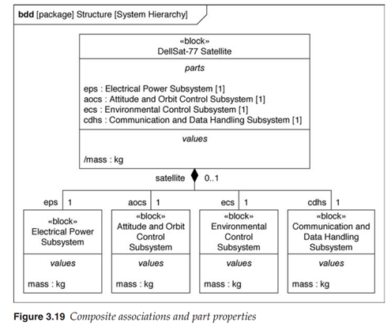
Top-Level STPA Control Structure vs. Architecture Model
ABSTRACT FUNCTION
STPA Control Structure “Attitude Controller” and “Attitude Controlled Process” trace to “Attitude and Orbital Control System (AOCS)” on DelSAT architecture
AOCS will be the primary portion of the architecture to initially focus on
PHYSICAL FORM
STPA Report Control Structure
DelSAT Architecture in SysML
The AOCS Can Be Considered as the Realization of the Attitude Controller and Controlled Process in the STPA Report

Slide 111
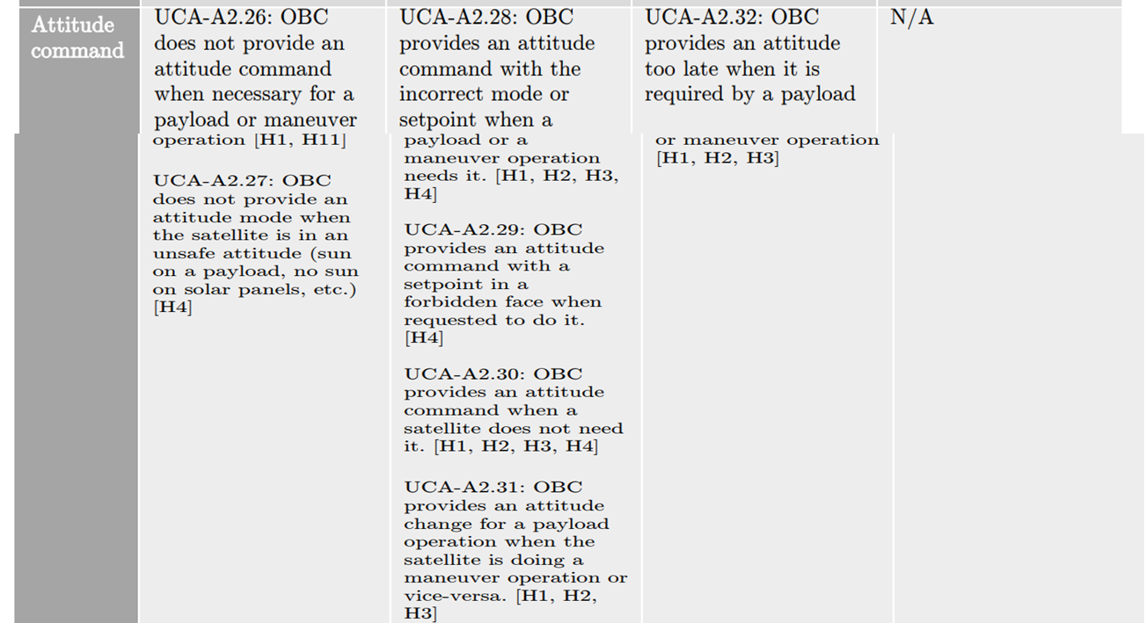
Relevant STPA Control Action (Attitude Command)
Identify each of the UCAs associated with the relevant control actions from the STPA report
Use contexts associated with the previously identified Hazards of Interest
STPA Report Hazardous Control Action Table (Excerpt)
The STPA Report Identifies the Various Contexts in Which the Attitude Commanded Can Lead to a Hazard

Slide 112
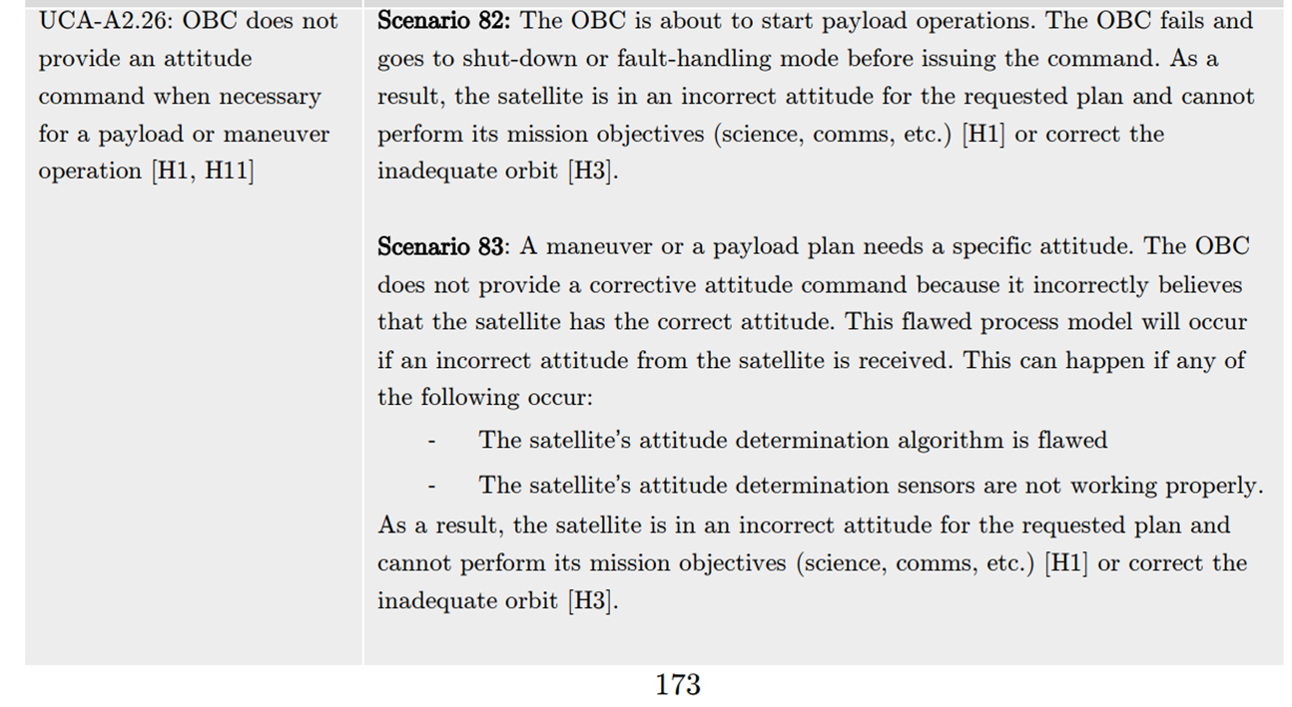
Corresponding Loss Scenarios from STPA Report
UCA-A2.26 is a previously identified Hazardous Control Action of Interest
UCA maps to multiple scenarios in the STPA Report
STPA Report Loss Scenarios
Scenario 82 & 83 are Both Relevant Scenarios (we will further Analyze 82)

Slide 113
Could these scenarios occur in the DelSAT Architecture / Artifacts?
HCA 2-26: On Board Controller (OBC) does NOT provide an ATTITUDE command when necessary for a Payload or Maneuver operation.
STPA report Scenario 82 (based on HCA 2-26)
The On Board Controller (OBC) is about to start payload operations. The OBC fails and goes to shut-down or fault handling mode before issuing the command. As a result, the satellite is in an incorrect attitude for the requested plan and cannot perform its mission objectives (science, comms, etc) (H-1) or correct the inadequate orbit (H-3)
We Now Explain the Scenario from the STPA Report Using the DelSAT Architecture / Artifacts

Slide 114
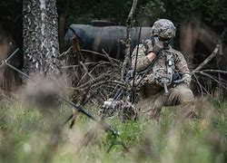
“Operationalizing” Scenario 82 with mission Context

Slide 115
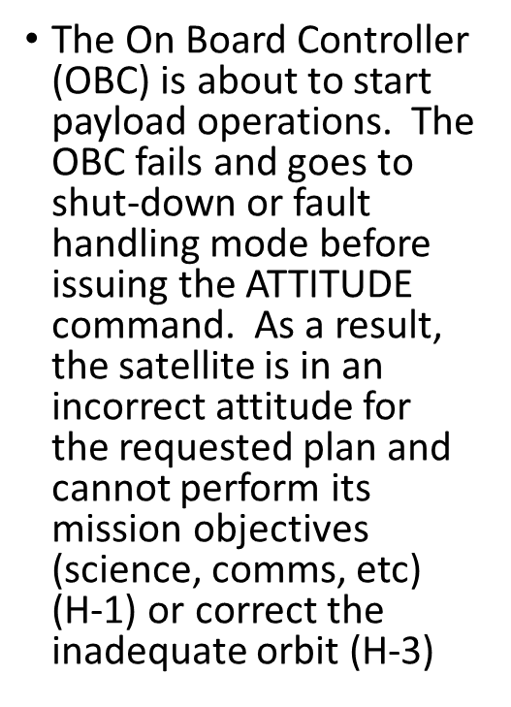
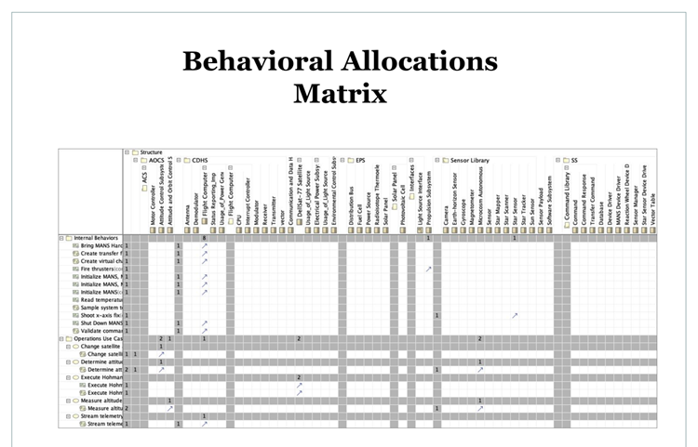
Determine Relevant Parts of Architecture Model & Related Artifacts
SysML artifacts such as behavioral allocations matrix help identify the relevant portions of the architecture to explain the scenario
STPA Report Loss Scenario 82
DelSAT SysML Architecture Behavior
Allocation Matrix
STPA Scenario 82 & 83 are Both Relevant to DelSAT
Let’s further analyze 82

Slide 116
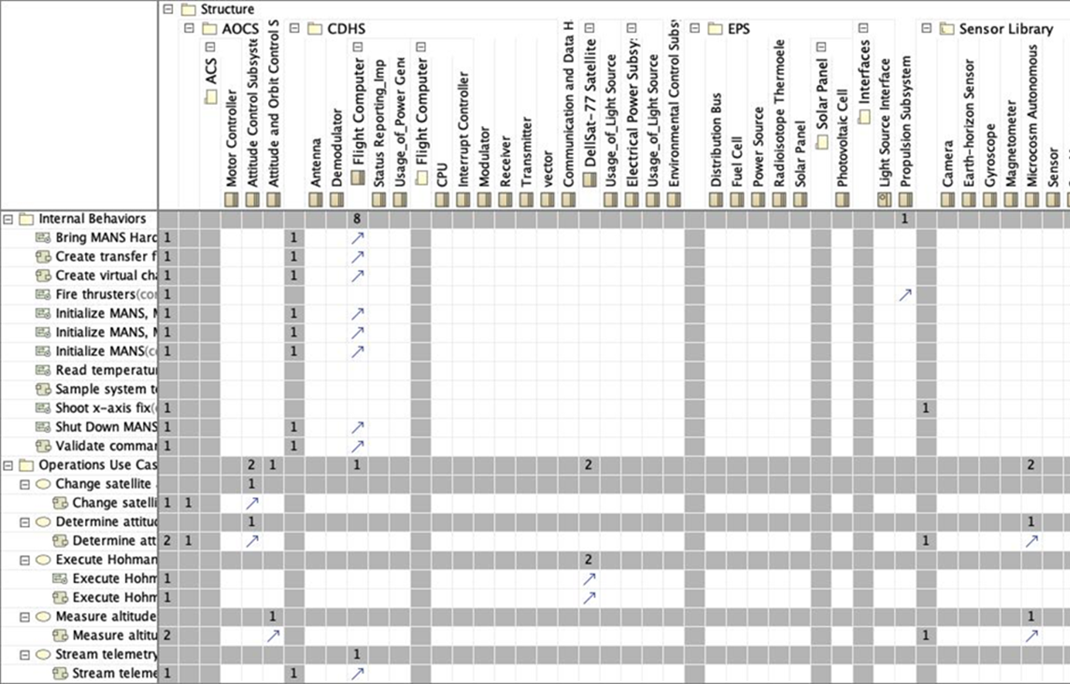
Identify the Related Architectural Elements
Associated with Misbehavior
Identify the Relevant Misbehaviors referenced in the scenario

Slide 117
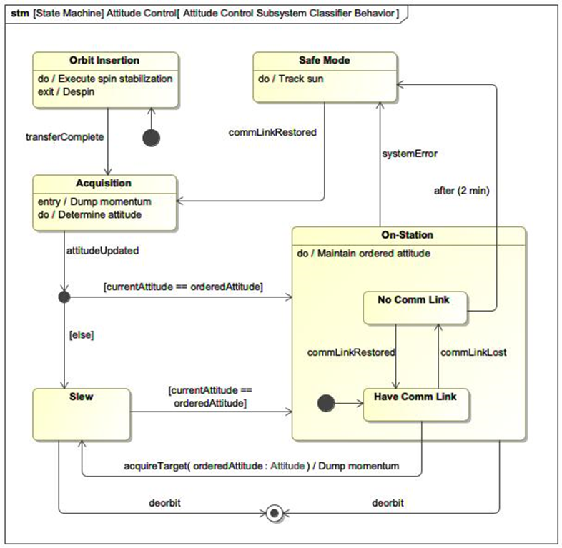
Explain the Scenario Using Referenced Artifacts
Control over DelSAT Attitude is described by a state machine diagram
The state machine represents the planned design behavior
The loss scenario identifies the relevant system misbehavior
DelSAT Attitude Control State Machine from Magic Draw Model
The State Machine is the “Game Field” That is Used to “Play Out” The Loss Scenario (#82) to Try and Find Issues

Slide 118
STPA report Scenario 82 (based on HCA 2-26)
The On Board Controller (OBC) is about to start payload operations. The OBC fails and goes to shut-down or fault handling mode before issuing the ATTITUDE command. As a result, the satellite is in an incorrect attitude for the requested plan and cannot perform its mission objectives (science, comms, etc) (H-1) or correct the inadequate orbit (H-3)

Slide 119

SAFE Mode can be considered a “Fault Handling Mode”
STPA report Scenario 82 (based on HCA 2-26)
The On Board Controller (OBC) is about to start payload operations. The OBC fails and goes to shut-down or fault handling mode before issuing the ATTITUDE command. As a result, the satellite is in an incorrect attitude for the requested plan and cannot perform its mission objectives (science, comms, etc) (H-1) or correct the inadequate orbit (H-3)
As “designed” ANY system error reported sends DelSAT into Safe Mode

Slide 120
In SAFE Mode, DelSAT is Designed to Adjust Attitude to Track the sun
STPA report Scenario 82 (based on HCA 2-26)
The On Board Controller (OBC) is about to start payload operations. The OBC fails and goes to shut-down or fault handling mode before issuing the ATTITUDE command. As a result, the satellite is in an incorrect attitude for the requested plan and cannot perform its mission objectives (science, comms, etc) (H-1) or correct the inadequate orbit (H-3)
DelSAT is designed to stay in SAFE Mode when it believes there is no comm link present

Slide 121
STPA report Scenario 82 (based on HCA 2-26)
The On Board Controller (OBC) is about to start payload operations. The OBC fails and goes to shut-down or fault handling mode before issuing the ATTITUDE command. As a result, the satellite is in an incorrect attitude for the requested plan and cannot perform its mission objectives (science, comms, etc) (H-1) or correct the inadequate orbit (H-3)
Without a Comm link, in SAFE Mode, the DelSAT tracks the sun and is unable to determine the ATTITUDE required
X
“SLEW” Block is responsible for changing the DelSATs ATTITUDE. Without receiving the updated attitude, it will not attempt to change the DelSAT attitude

Slide 122
Generate an Amplified Scenario that Enhances the Narrative Using Details From the Referenced Artifacts
The DelSAT’s Attitude Control System is designed to enter safe mode if any system error is detected. If an error is reported just prior to a mission tasked attitude adjustment, the system will enter the SAFE Mode. While in the SAFE mode, the DelSAT adjusts its attitude to track the sun versus obeying the previously commanded attitude. The DelSAT remains in SAFE mode until comm link is restored, the system error resolved, and a new updated attitude (required for the mission can be issued).
While the design emphasizes safety, it does not necessarily allow for resilience (e.g. allow a mode where DelSAT will continue to maintain last commanded attitude versus tracking the sun when some system errors are detected. In other words, resilience can be improved by adding a reference monitor that will block the DelSAT from entering SAFE mode while in the middle of a critical mission phase supporting operations and certain system errors are present. Some critical errors may still force the system to SAFE mode, but this set of errors will be debated and agreed by stakeholders.
Identified A Missing Requirement To Better Define How DelSAT Should Behave When A System Error is Detected

Slide 123
STPA: Generating requirements and executable models

Slide 124
HCAs as a black-box model (transfer function)
  “HCA-1: ISS provides HTV Abort cmd too late after ISS is in the HTV abort path [H-1]”
  Requirement:
  “R-1: ISS shall provide HTV Abort cmd within TBD, before HTV abort path intersects ISS [HCA-1]”
Controller
(black box)
Outputs
Inputs
HCAs have the information needed to define the required inputs/outputs and behaviors.
If during concept phase: Use this to generate your architecture and requirements. “Bake-in” safety and security into the design and architecture.
If during/after development phase: Use this info to validate your architecture and requirements for safety and security.
© Copyright 2023 John Thomas

Slide 125
Context table for Free Drift control action
 | 1 | 2 | 3 | 4 | 5 | 6 | 7
 | Control Action | HTV Velocity | HTV Position | Flight status | Providing Control Action is Hazardous? | Not Providing Control Action is Hazardous? | Providing Too Early/Late is Hazardous?
1 | Free Drift | Approaching ISS | In Capture Box | Within Envelope | H-1; H-2 | No | No
2 |  | Approaching ISS | Not In Capture Box | Within Envelope | H-1; H-2 | No | No
3 |  | Not approaching ISS | In Capture Box | Within Envelope | No | H-1; H-2 | H-1; H-2
4 |  | Not approaching ISS | Not In Capture Box | Within Envelope | H-2 | No | No
5 |  | * | * | Outside Envelope | H-1; H-2 | No | No

Slide 126
Test-case generation
 | 1 | 2 | 3 | 4 | 5 | 6 | 7
 | Control Action | HTV Velocity | HTV Position | Flight status | Providing Control Action is Hazardous? | Not Providing Control Action is Hazardous? | Providing Too Early/Late is Hazardous?
1 | Free Drift | Approaching ISS | In Capture Box | Within Envelope | H-1; H-2 | No | No
2 |  | Approaching ISS | Not In Capture Box | Within Envelope | H-1; H-2 | No | No
3 |  | Not approaching ISS | In Capture Box | Within Envelope | No | H-1; H-2 | H-1; H-2
4 |  | Not approaching ISS | Not In Capture Box | Within Envelope | H-2 | No | No
5 |  | * | * | Outside Envelope | H-1; H-2 | No | No

Slide 127
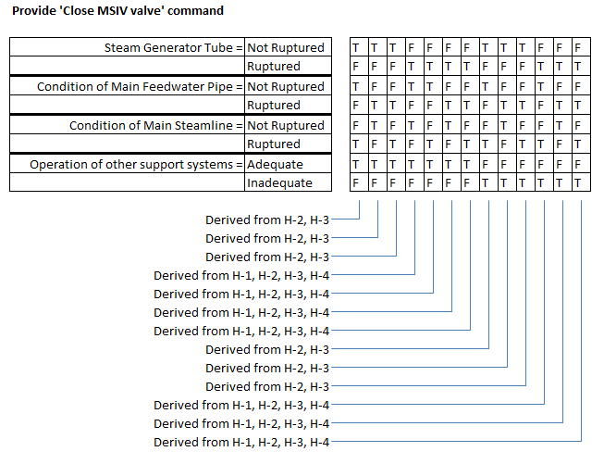
Automatically generated requirements
Generated requirements / initial model for HTV / ISS crew interaction
FD
In CB,
Stat.,
Stabile
In CB,
Stat.,
FD
Act.
Act.
Drift
Outside CB
Abort
Abort
Aborted
Abort
In CB,
Stat., FD
Cap
Capture
Retrieve
Retrieved
Executable!

Slide 128
Aircraft Engine Thrust Control Example
Machine-readable HCAs
 | 1 | 2 | 3 | 4 | 5 | 6 | 7 | 8 | 9 | 10 | 11 | 12
 | Control Action | Ref. Engine Stuck at High Thrust | Takeoff is Rejected | Aircraft is In Flight (after V1) | Ref. Engine Shutdown | Restart Cmded | Other Engine Shutdown | Aircraft is In Landing Roll | Hazardous to Provide Control Action? | Hazardous to Not Provide Control Action? | Hazardous to Stop Applying Control Action? | Hazardous to Continue Applying Control Action?
1 | TCM Shutdown Cmd | Stuck | RTO | * | * | * | * | * | No | Yes | No | No
2 |  | * | * | In Flight | * | * | * | * | Yes | No | No | No
3 |  | Not Stuck | RTO | * | * | * | * | * | Yes | No | No | No
4 |  | Not Stuck | * | * | * | * | * | Landing Roll | Yes | No | No | No
5 |  | * | * | * | * | * | Shutdown | * | Yes | No | No | No
6 |  | * | * | * | No | * | * | * | No | No | Yes | No
7 |  | * | * | * | * | No | * | * | No | No | No | Yes
Generated counter-example
Conflict derived from HCAs 1 and 5: Suppose Rejected Takeoff (RTO) occurs with Ref. Engine Stuck at High Thrust. Other Engine is already Shutdown. TCM will provide Shutdown Cmd to Ref. Engine. Hazardous?
© Copyright 2023 John Thomas

Slide 129
Automatically generating executable requirements
Ref. Engine = | Stuck at High Thrust |  | T |  | T |  | T
 | Not Stuck at High Thrust |  | F |  | F |  | F
Takeoff = | Rejected |  | T |  | T |  | T
 | Not Rejected |  | F |  | F |  | F
Flight = | In Flight (after V1) |  | F |  | F |  | F
 | Not in Flight |  | T |  | T |  | T
Ref. Engine SD = | Shutdown |  | * |  | * |  | *
 | Not Shutdown |  | * |  | * |  | *
Other Engine = | Shutdown |  | F |  | F |  | F
 | Not Shutdown |  | T |  | T |  | T
Restart = | Commanded |  | * |  | * |  | *
 | Not Commanded |  | * |  | * |  | *
Landing Roll = | In Landing Roll |  | T |  | T |  | T
 | Not in Landing Roll |  | F |  | F |  | F
AND
OR
OR
These are formal TCM behavioral requirements, aka an executable TCM model. These models can be generated directly from HCAs before any software development has begun. This is a full specification of states and transitions in a state machine / state chart for TCM at this point in the analysis. We’ll continue STPA to identify potential flaws and gaps in this specification / model and we’ll refine the HCAs (and the models generated from HCAs).
© Copyright 2023 John Thomas

Slide 130
Real World STPA User Applications and Results
WHO

Slide 131

USAF Complex System Example
Air Force Sentinel ICBM
STPA-Sec improved outcomes during Concept Phase
USAF wrote STPA-Sec into contract with NG
Mission Defense Team established
  Formally trained
  Coached / mentored post-training
  Worked closely with NG SSE team
“Using STPA-Sec allowed GBSD to design systems that minimize security vulnerabilities while meeting program requirements and schedule”
DoD A&S Report¹
1. Cybersecurity for DoD Acquisition Program Execution: Best Practices for the “Major Capability Acquisition Pathway” Insights from GBSD

Slide 132
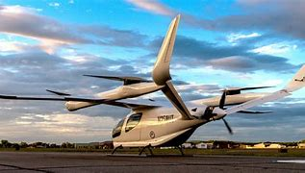
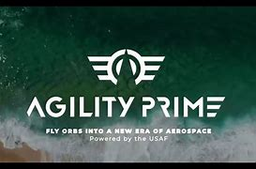
Agility Prime
AFOTEC Det 2 used STPA-Sec to evaluate prototype architectures
Developed security model based on very general mission specification and industry engineering foundations
Two startups valued both the insights generated and the lightweight nature of the STPA-Sec analysis
“STPA-Sec has proven valuable not only to test planning, but has positively influenced design decisions to enhance safety and security…What a great use of model-based systems engineering to partner with prototype developers to find and fix critical control and security issues early…We've seen meaningful value and system design
impact from only two days of effort.”
AFOTEC T&E Exchange, Issue 7, October 2021

Slide 133
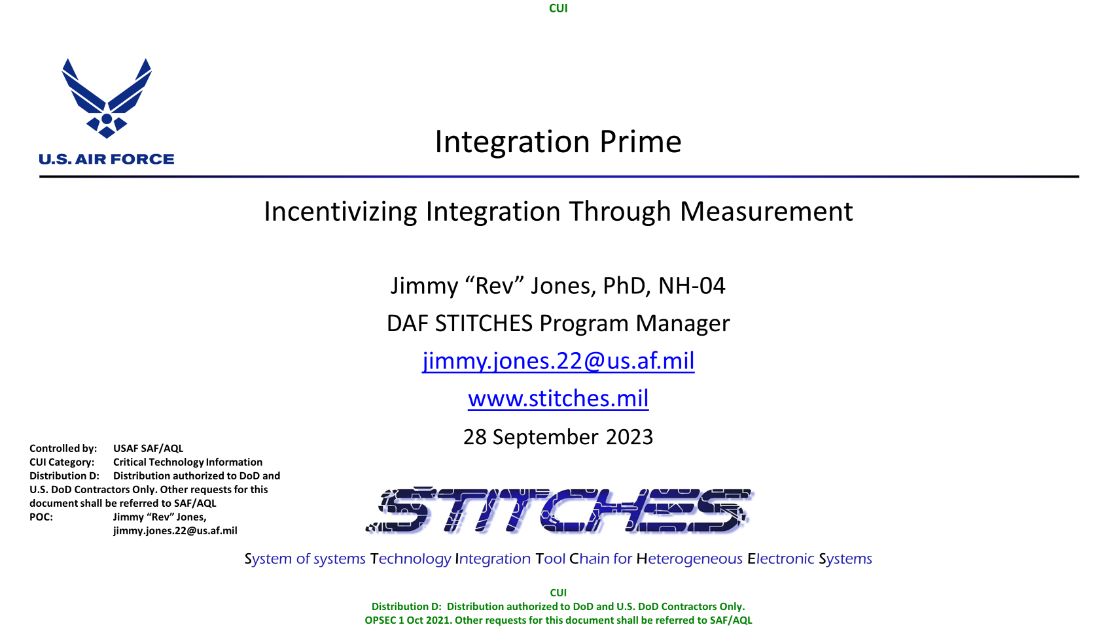
Integration Prime
STPA-Sec used as foundation for new Secure Integration Process
Provides early operational risk assessments
Generates artifacts to enable multi-level Authority to Operate discussions
  Secure Integration Kit
  Gauntlet Box
Validated at CDAO-sponsored Hackathon in Feb ‘24
STPA-Sec is the Foundation for Securing System-of-Systems. We are Building the STITCHES Secure Integration Process on top of it…It clearly enables early assessment of mission operational risk and provides the design guidance to our engineers
Dr Jimmy “Rev” Jones, Integration Prime Lead

Slide 134

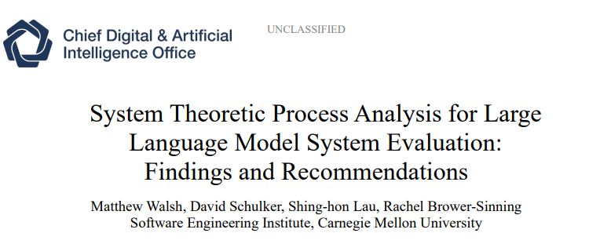
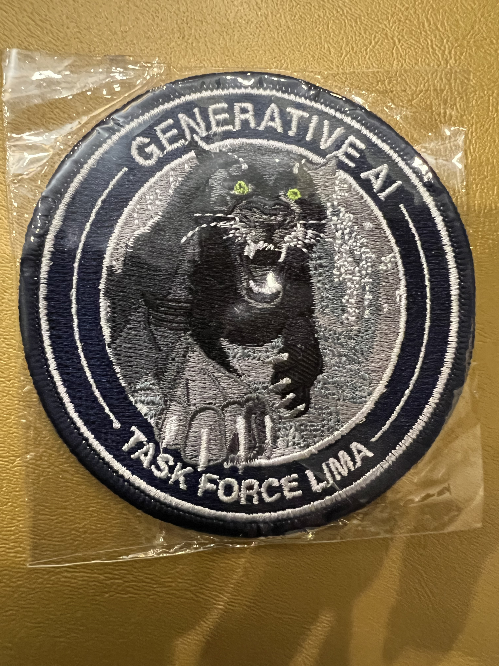
Task Force LIMA
CDAO identified STPA as a methodology to address LLM risk in DoD systems
Software Engineering Institute, Carnegie Melon University studied and evaluated STPA
  Published 3 papers
  All recommend DoD adoption of STPA
“Given the inherent complexity of LLM systems, a systematic approach is needed to identify the multitude of potentially adverse behaviors stemming from various sources. STPA serves as a valuable tool to identify subsystem behaviors and interactions that could potentially result in unacceptable losses... Based on these findings, we recommend the DoD use STPA to develop, evaluate, and implement LLM systems that are safe by design. ”

Slide 135

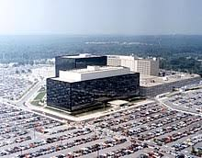
National Security Agency
Feb ‘20 Familiarization course
29 Engineers primarily from
Weapon System Cybersecurity Branch
Assessment & feedback
  “phenomenal…critical relevance to our customer community”
  “This methodology (STPA-Sec) is needed on various projects at this time”
  “Very applicable to my work. Will help refine focus / save time, and solve the right problems”

Slide 136
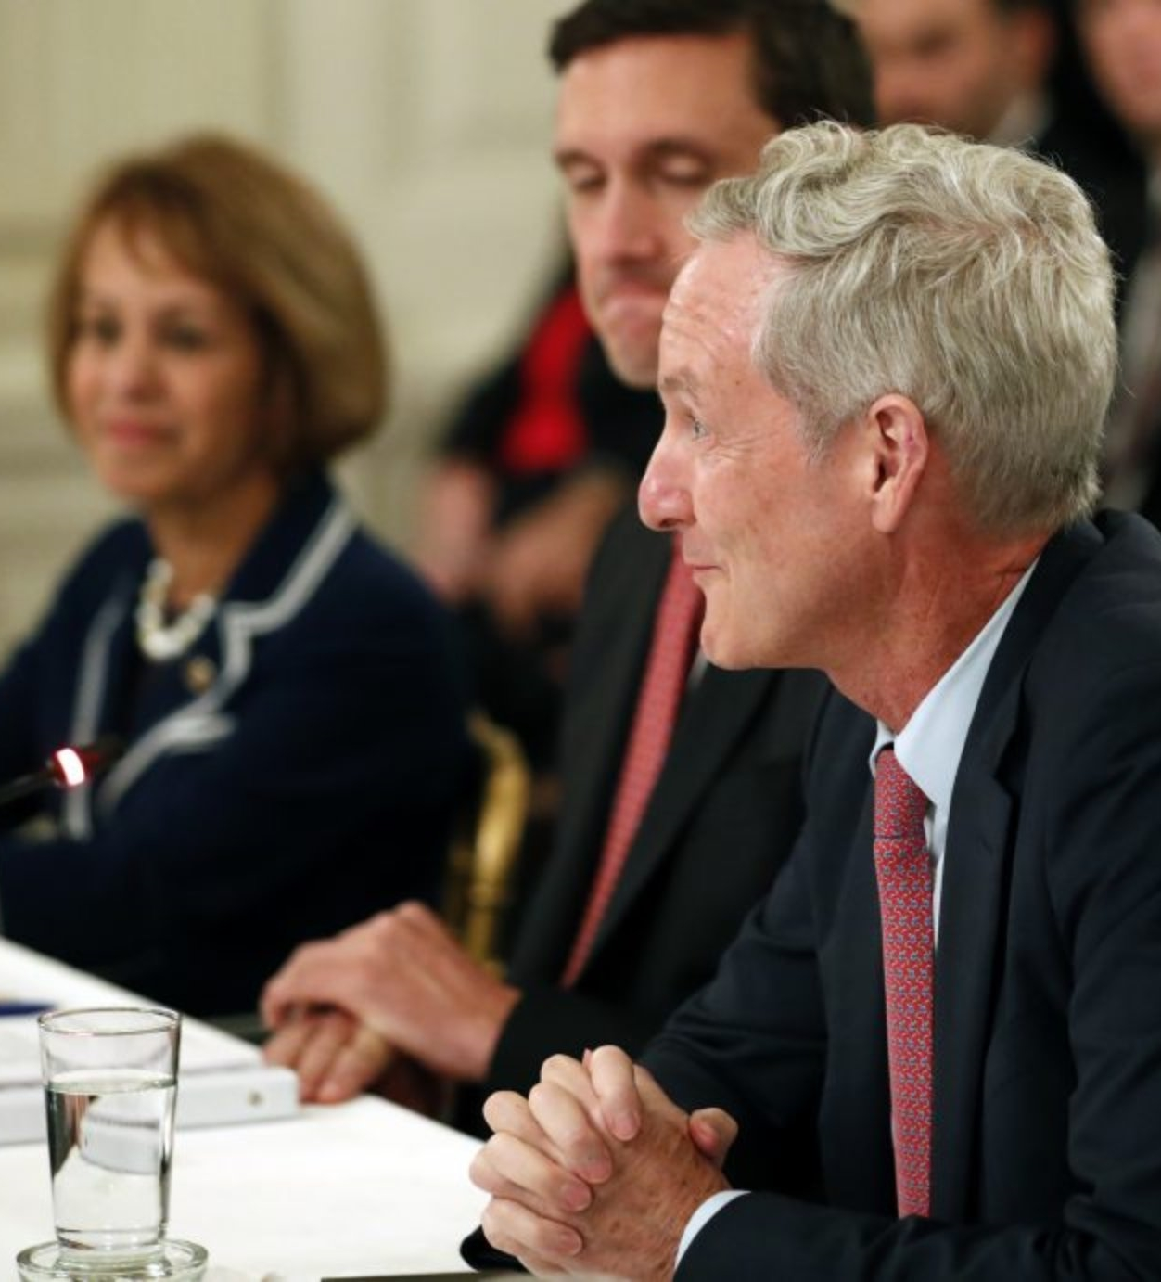
Akamai
President and CEO Tom Leighton’s advice in
Whitehouse meeting of Tech CEOs on improving
Federal Cybersecurity
“Cybersecurity is a growing area of Akamai’s business, one where IT organizations seek expert help repeatedly. Solutions that work for private companies can also work for federal agencies, specifically:…
Protecting federal data through role and policy-based access controls
Encouraging “security by design” through systems analysis methodologies like STPA-SEC
Ref: https://www.linkedin.com/pulse/technology-ceos-share-best-practices-us-government-cios-tom-leighton-1/

Slide 137

IT Alliance for Public Sector Cybersecurity
Key Recommendation: Institutionalize “security by design” for federal IT modernization and development.
  Included within a DevSecOps approach needs to be a “security by design” process, such as a System- Theoretic Process Analysis for Security (STPA-Sec) for all future development. Security is not an add-on, it needs to be a fundamental part of all IT design, from start to finish. (p.37-38)
*Ref: IT Alliance for Public Sector, “Tech Industry’s Recommendations for Federal IT Modernization”

Slide 138
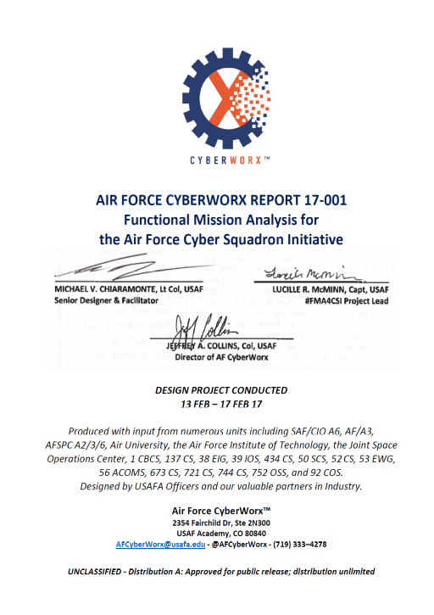
USAF Experience with Functional Mission Analysis (Variant of STPA-Sec)
“Highlighted during the sprint was that FMA is not simply a cyber tool; FMA is about understanding how cyber impacts the AF missions and how using FMA to tailor cyber defenses assures operational missions and decision superiority for Airmen. Cyber FMA will present cyber to the base and wing commanders in terms of mission assurance and mission impact”
-- Air Force CYBERWORX
Ref: Air Force CyberWorx Report 17-001: Functional Mission Analysis for the Air Force Cyber Squadron Initiative

Slide 139
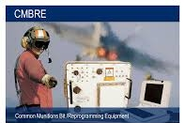

Common Munition BIT and Reprogramming Equipment (CAMBRE) Service Life Extension
Cyber testers drove more secure redesign through STPA-Sec
6-week total effort (1-2 testers)
Identified 120 hazards, validated 60 planned constraints (plus recommended 30 new ones)
Results convinced program office to remove features that eliminated additional hazards
  Enabled program office to defend decisions to stakeholders
“STPA-Sec Vastly Outshines Existing Processes and We Will be Switching it to For the Rest of Our Test Planning” USAF Capt & AFOTEC Cyber Test Lead

Slide 140
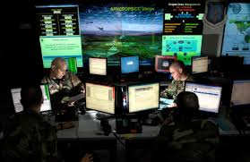

Unified Platform
STPA-Sec used by AFOTEC Cyber Testers to support DevSecOps process improvement
Unacceptable Losses and Hazards mapped into existing LevelUp workflow
STPA-Sec functional models focus continuous security testing resources
AFOTEC cyber testers plan to avoid one-off tests on constantly changing code base

Slide 141
STPA-Sec Wargaming Integrates with DoD CTT Process
Results and insights can be captured and cataloged
Approach is particularly useful in providing data to refute faulty assumptions, highlight flawed logic, etc.
Wargaming supports better estimate of operational risk and can be used to support risk / reward discussions for a particular feature / function
Removing features is most effective action in decreasing complexity and increasing security
Flawed logic
Conflicting goals
Poor Assumptions
Wrong Problem
Missing requirements
Incomplete requirements
Wargaming via STPA-Sec Provides Another Opportunity to Catch and Fix Flaws that Drive Up Costs in Complex Software Intensive Systems

Slide 142
STPA/STPA-sec in Industry Standards
ISO/PAS 21448: SOTIF: Safety of the Intended Functionality
  STPA used assess safety of automotive systems
ASTM WK60748
  “Standard Guide for Application of STPA to Aircraft”
SAE AIR6913
  “Using STPA during Development and Safety Assessment of Civil Aircraft”
RTCA DO-356A
  “Airworthiness Security Methods and Considerations”
  STPA-sec used for cybersecurity of digital systems
IEC 63187
  “Functional safety - Framework for safety critical E/E/PE systems for defence industry applications”
SAE J3187
  “Recommended Practice for STPA in Automotive Safety Critical Systems”
SAE J3187A
  STPA Recommended Practice for Safety-Critical Evaluations in Any Industry”
EPRI 3002016698 & 3002018387
  STPA for digital I&C in nuclear power
NIST SP800-160 Vol2
  “Developing Cyber Resilient Systems: A Systems Security Engineering Approach”
  “Attack scenarios can be represented as part of a model-based engineering effort […] based on identification of loss scenarios from System-Theoretic Process Analysis (STPA).
MoD Standard 00-056
  Ministry of Defence Safety Management Requirements for Defence Systems
Code of Practice: Cyber Security and Safety
  Developing Cyber Resilient Systems: A Systems Security Engineering Approach
IET 978-1-83953-318-1
  “Code of Practice: Cyber Security and Safety”
  Recommends use of STPA for Safety & Security
NEI 20-07 Rev D
  “Guidance for Addressing Common Cause Failure in High Safety-Significant Safety-Related Digital I&C Systems”
  Outlines STPA process for digital technology at nuclear power stations
UL 2800-1:2022: Standard for Medical Device Interoperability
  Explicitly mentions STPA for performing system-level hazard analysis and control loop analysis

Slide 143
Autonomy Quick Example

Slide 144

Safety-critical AI/ML: Self-Driving Cars

Slide 145
Control Structure Refinement
Pilot
Copilot
Apollo HMI
ESTOP
Apollo 2.0
Software System
Monitor / Guardian
Dataspeed
Sensors
Lincoln MKZ
© Copyright 2023 John Thomas

Slide 146
Level 2
Control Structure Refinement
Level 3
Pilot
Copilot
?
Apollo HMI
ESTOP
Apollo 2.0
Software System
Monitor / Guardian
Dataspeed
Sensors
Lincoln MKZ
© Copyright 2023 John Thomas

Slide 147
Level 2
Control Structure Refinement
Level 3
Pilot
Copilot
Env.
Apollo 2.0
Destination
Routing
Apollo HMI
Route Waypoints
New route request
Planning
ESTOP
Apollo 2.0
Software System
Objects, Paths
Desired Trajectory
Prediction
HD
Map
Objects, Scenery
Objects, Scenery
Location
Monitor / Guardian
Control
Perception
Localization
Actuation (throttle, brake, steer, shift)
Telephoto cam
Wide-angle cam
Lidar images
Radar images
Etc.
GPS
Inertial reference
Camera images
Lidar images
Radar images
Dataspeed
Sensors
Vehicle status
Lincoln MKZ
Env.
Thomas, 2019
© Copyright 2023 John Thomas

Slide 148
Level 2
Control Structure Refinement
Level 3
Pilot
Copilot
Env.
Apollo 2.0
Destination
Routing
Apollo HMI
Route Waypoints
New route request
Planning
ESTOP
Apollo 2.0
Software System
Objects, Paths
Desired Trajectory
Prediction
HD
Map
Objects, Scenery
Objects, Scenery
Location
Monitor / Guardian
Control
Perception
Localization
Actuation (throttle, brake, steer, shift)
Telephoto cam
Wide-angle cam
Lidar images
Radar images
Etc.
GPS
Inertial reference
Camera images
Lidar images
Radar images
Dataspeed
Sensors
Vehicle status
Lincoln MKZ
Env.
Thomas, 2019
© Copyright 2023 John Thomas

Slide 149
Example Control Structure
Apollo 2.0
Destination
Routing
Route Waypoints
New route request
Planning
Objects, Paths
Desired Trajectory
Prediction
HD
Map
Objects, Scenery
Objects, Scenery
Location
Control
Perception
Localization
Actuation (throttle, brake, steer, shift)
Telephoto cam
Wide-angle cam
Lidar images
Radar images
Etc.
GPS
Inertial reference
Camera images
Lidar images
Radar images
Vehicle status

Slide 150
Control Structure vs.
Data Processing Pipeline

Slide 151
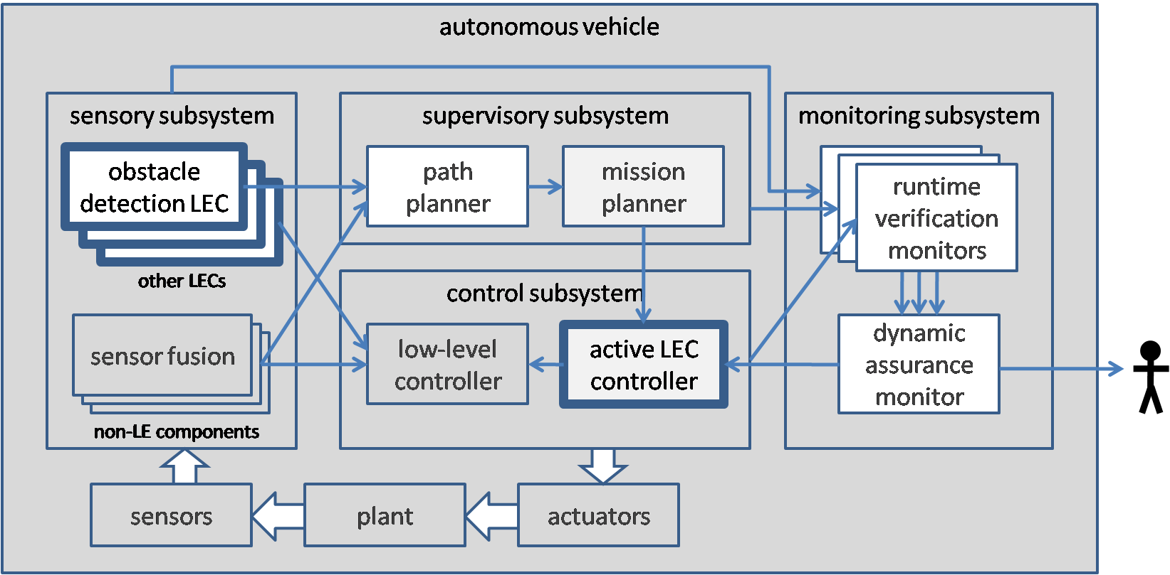
Example processing pipeline
Where are the control loops?
Is each control action informed by appropriate feedback information?
Integrated Static and Dynamic Approaches to High-Assurance for Learning-Enabled Cyber-Physical Systems
https://rtg.cis.upenn.edu/assured-autonomy/

Slide 152
Application to organizations and management

Slide 153
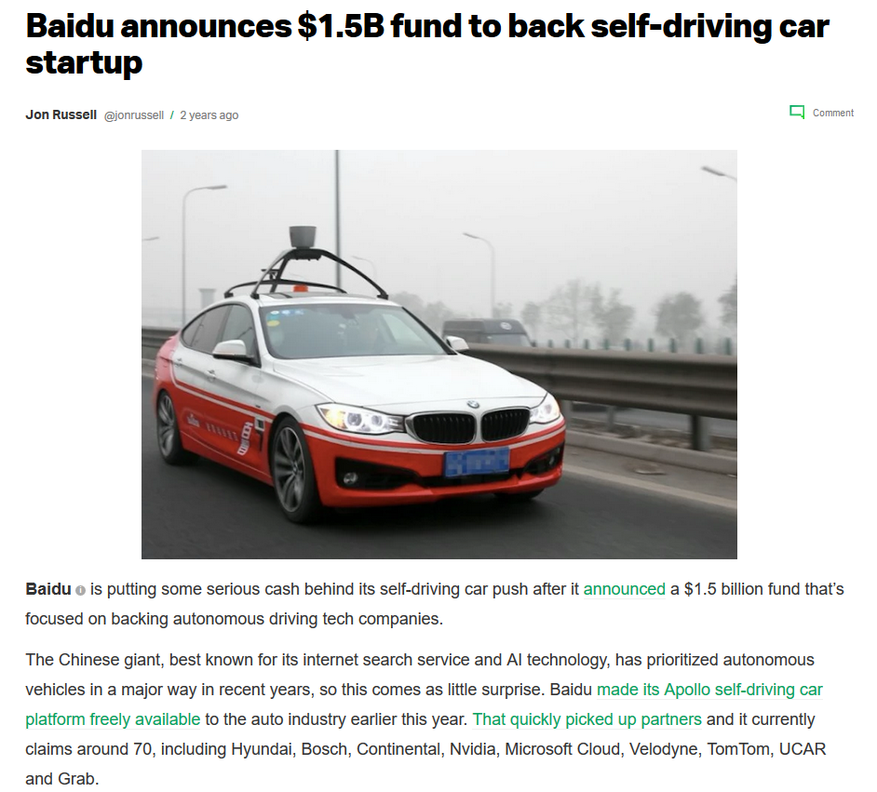
Company X
Will use Baidu’s Apollo software
$150B+ annual revenue
Plans to demonstrate self-driving car on public roads
Convinced that a systems approach to safety was required
Decides to use STPA for “due diligence”

Slide 154

Control Structure Refinement
Level 1
Level 2
Safety Drivers
Program Management
Pilot
Copilot
Env.
Go/No-Go
“Go” criteria
Objectives
Engineering Team
Legal
Go/
No-Go
Apollo HMI
System Integrators
Test Route Planners
State Law,
Insurance,
Etc.
Post-drive reviewers
Safety Engineers
ESTOP
Apollo 2.0
Software System
Go/No-Go
Trainers
Safety Driver(s)
Env.
Dataspeed
Sensors
Env.
Lincoln MKZ
Env.
Autonomous Vehicle
Autonomous Vehicle
© Copyright 2023 John Thomas

Slide 155
Control Structure
Before STPA
After STPA
Program Management
Program Management
Go
“Go” criteria
Go/No-Go
Objectives
Engineering Team
Legal
Engineering Team
Legal
Go/
No-Go
System Integrators
Test Route Planners
System Integrators
Test Route Planners
State Law,
Insurance,
Etc.
Post-drive reviewers
Safety Engineers
Post-drive reviewers
Safety Engineers
Go/No-Go
Trainers
Trainers
Safety Driver(s)
Env.
Safety Driver(s)
Env.
Autonomous Vehicle
Autonomous Vehicle
Env.
Env.
© Copyright 2023 John Thomas

Slide 156
STPA Compared to Other Methods

Slide 157

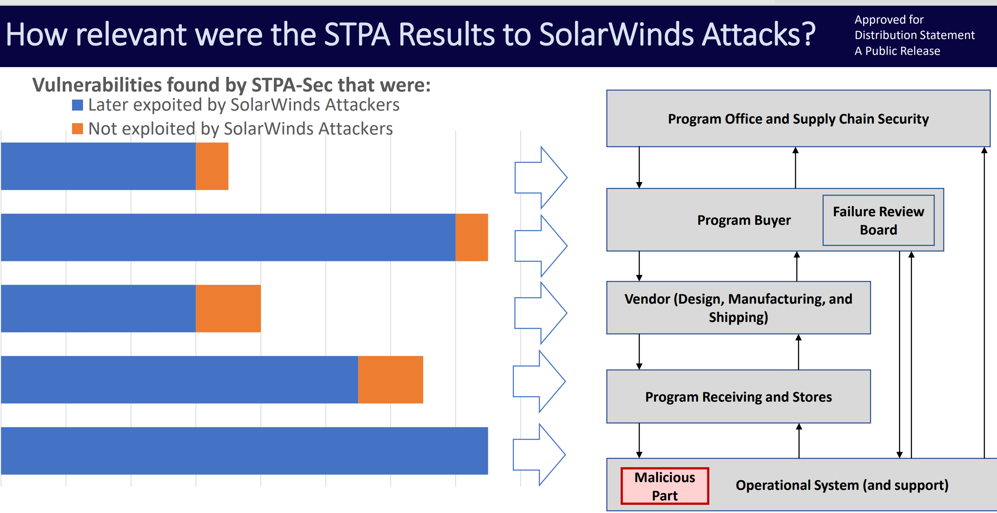
Prevented Solar Winds Losses
Oct 2020: STPA identified a set of vulnerabilities. DoD customer updated their processes and controls to eliminate vulnerabilities based on STPA-Sec results
STPA anticipated the actual supply chain vulnerabilities later used by SolarWinds hackers
STPA identified vulnerabilities that were not effectively mitigated by traditional techniques
• STPA generated effective new solutions that were implemented by DoD customer, eliminating vulnerabilities before the attacks. The vulnerabilities remained in other supply chains where STPA was not used.
Ref: http://psas.scripts.mit.edu/home/wp-content/uploads/2021/06/2021-06-25-1210__Bear-Thomas.pdf

Slide 158
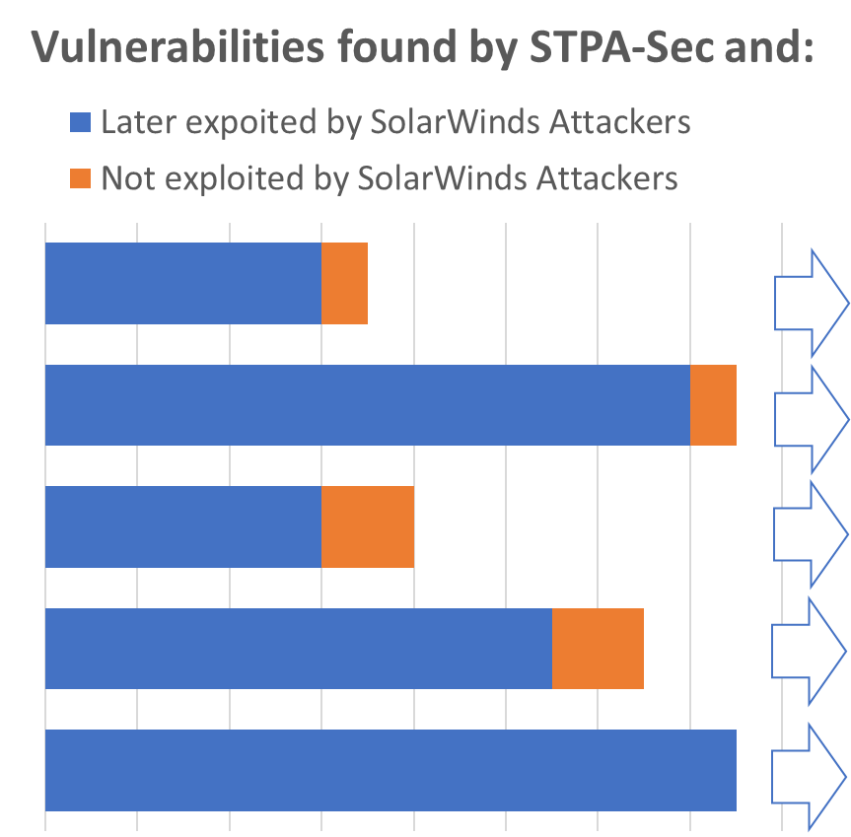
STPA Results compared to SolarWinds Attacks.
One entity applied STPA for security assessment two months before the infamous SolarWinds attacks. The entity successfully used STPA results to pre-emptively discover and address vulnerabilities before any attacks occurred. Post-SolarWinds, the entity reviewed the SolarWinds attacks and compared to the STPA results obtained two months prior. STPA had identified the exact vulnerabilities in advance.
Program Office and Supply Chain Security
Program Buyer
Failure Review Board
Vendor (Design, Manufacturing, and Shipping)
Program Receiving and Stores
Operational System (and support)
Malicious Part
STPA identified the SolarWinds vulnerabilities 2 months before the attacks

Slide 159

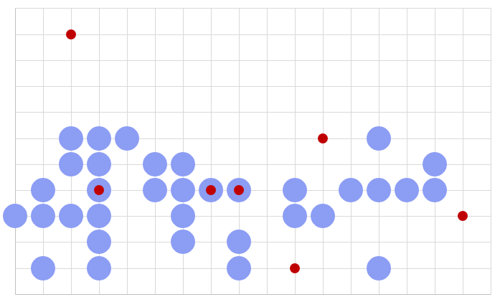
Solutions produced using STPA
Identified without STPA
Low cost, highly effective
Application: Complex software
STPA produced:
Larger number of solutions
Lower-cost solutions
More effective solutions
Identified by STPA
Cost
Effectiveness
Out of scope for initial STPA effort
STPA enabled implementation of
most effective & lowest-cost solutions
Falzone and Thomas, 2021

Slide 160



Embraer STPA application
2016: Air Management System
  Identified 200+ safety constraints (requirements) and 700+ design recommendations to eliminate or mitigate hazards (satisfy the safety constraints).
Embraer Aircraft Control System analysis
Control structure: Scalable and traceable
Captured with existing standard processes
Captured only in advanced stages, STPA found earlier
Captured only with STPA
Cost benefit
Safety/
Security benefit
Notes:
160

Slide 161
Industry STPA Comparison
 | Safety-related Functional Requirements | Safety-related System Design Requirements | Safety-related Design Solutions
Number of STPA Safety Constraints (SC) that were already well-enforced by requirements/design (10 or more relationships) | 8 | 75 | 236
STPA Safety Constraints (SC) that were minimally addressed by requirements/design (5 or fewer relationships) | 208 | 75 | 34
STPA Safety Constraints (SC) that were not covered by any existing requirements or solutions | 82 | 20 | 15
Covered
These STPA results were addressed before STPA was applied.
Not Covered
These STPA results had NO existing mitigations or corrective measures. These were accidents waiting to happen.
  Table: Use of STPA in the Development of a Reactor Protection System, Paul Butchart (NuScale), 2020

Slide 162

Evaluating STPA for Cybersecurity
Control
Actions
Teams of practitioners used STPA to anticipate new cybersecurity scenarios and controls to prevent them
Feedback
Digital Controller
Control algorithm
Process
Model (beliefs)
Control
Actions
Feedback
Feedback
Generator Breakers
Other Processes
Video frame from simulated cyber attack on generator

Slide 163


Types of accident causes found by STPA
Types of accident causes found by FMECA
FMECA causes for FM1
Rodrigo Sotomayor, 2015, “Comparing STPA and FMEA on an Automotive Electric Power Steering System”

Slide 164

A comparison of STPA and FMEA
Rodrigo Sotomayor
Application: Electric Power Steering System
Discovered by STPA & FMEA
Discovered by STPA Only
Discovered by FMEA Only
FMEA Only
(Not covered by STPA)
0%
Rodrigo Sotomayor, 2015, “Comparing STPA and FMEA on an Automotive Electric Power Steering System”
*Using SAE J1739 (DFMEA and PFMEA)

Slide 165


Valeo Evaluation of STPA
Application: Range Extender System for Electric Vehicles
  Results:
  - FTA/CPA took 3 times effort of STPA
  - STPA identified key cases missed by FTA/CPA

Slide 166

Ballistic Missile Defense System (MDA)
STPA not performed upfront by company
Gov required 3rd party non-advocate assessment before deployment.
STPA was applied late by 3rd party, right before deployment and field testing
  Very limited funding: 5 months, 2 people unfamiliar with the system (but aware of STPA and ready to try something new)
  STPA found multiple catastrophic flaws that had been overlooked, leading to decision to delay deployment ~6 months to fix them. Gov deemed remaining STPA results significant and required fixes (and waivers) for 10 additional years.
  Significant avoidable costs.
  Company internal response: “Why didn’t we catch these ourselves? Why didn’t we use STPA upfront?”
Includes sea-based sensors on the Aegis platform, upgraded early warning radars (UEWR),
the Cobra Dane Upgrade (CDU), Ground-based Midcourse Defense (GMD)
Fire Control and Communications (GFC/C), a Command and Control Battle Management
and Communications (C2BMC) Element, and Ground-based interceptors (GBI).
Future block upgrades were originally planned to introduce additional Elements into the BMDS, including Airborne Laser (ABL) and Terminal High Altitude Area Defense (THAAD).

Slide 167


Slide 168



2022
Purpose:
The Transportation Research Board of the National Academies of Sciences, Engineering, and Medicine was formed to ‘identify, categorize, and analyze emerging safety trends in air transportation’. This request from Congress was made in the aftermath of two fatal accidents involving Boeing 737 Max 8 aircraft
https://nap.nationalacademies.org/catalog/26673/emerging-hazards-in-commercial-aviation-report-1-initial-assessment-of-safety-data-and-analysis-processes

Slide 169
Purpose:
The Transportation Research Board of the National Academies of Sciences, Engineering, and Medicine was formed to ‘identify, categorize, and analyze emerging safety trends in air transportation’. This request from Congress was made in the aftermath of two fatal accidents involving Boeing 737 Max 8 aircraft
2022
A new, more comprehensive accident causality model has been proposed by Leveson (2011). … In this sense, it is an extension of the old models and can handle today’s and future systems that contain software, sophisticated automated components, management decision making, complex cognitive decision making by operators such as pilots or air traffic controllers, etc.
STAMP not only includes traditional accident causes, such as failure events slipping past defenses as described in the Swiss cheese model, but also accidents resulting from system design errors where each component operates as designed but their operation together results in a hazardous state, perhaps in circumstances not considered during design or in operating conditions that violate design assumptions. In this model, accidents occur when there are inadequate constraints on the interactions of the components of the system by some layer of the socio-technical system.
The role of the system engineer or system safety engineer is to identify the design constraints necessary to maintain safety and to ensure that the system design, including the social and organizational aspects of the system and not just the physical ones, enforces them (Leveson, 2004, p. 254).
https://nap.nationalacademies.org/catalog/26673/emerging-hazards-in-commercial-aviation-report-1-initial-assessment-of-safety-data-and-analysis-processes

Slide 170



The benefits of an STPA analysis are that it provides a methodical means of performing a hazard analysis. The analysis is comprehensive in that it encompasses the software’s behavior and interactions with other software, hardware, and operators during the entire system’s runtime. The system behavior is represented in a simple control structure diagram, which allows for ease of review by all project stakeholders. After a thorough analysis, failure events and a wide range of inadequate controls were detected. STPA is focused because effort is concentrated where the control structure impacts safety the most.
STPA is relatively new, but its use so far shows great promise. When compared with standard hazard and failure analyses, such as FTA and failure modes and effects analysis (FMEA), STPA has done much better on real systems in terms of identifying design errors and requirements errors that could not be identified by the standard techniques.
Report from FAA-sponsored project with MIT
https://www.faa.gov/aircraft/air_cert/design_approvals/air_software/media/TC-15-57.pdf

Slide 171































~10 Years of Empirical Evaluations of STPA in Aviation
2012
2017
2017
2023
More info: http://psas.scripts.mit.edu/home/wp-content/uploads/2023/2023-06-06-1010__John-Thomas__PUB.pdf

Slide 172
STPA: The most popular approach we haven’t tried?
Organizations (2019):
Aalto University, Finland
ABS Consulting
Advanced Consulting & Engineering (AC&E)
Advanced Management Strategies Group (AMSG)
Adventium Labs
Aero Engine Controls
Aeronautical Accident and Incident Investigations Commission
Aeronautics and Space Institute (IAE)
Aeronautics Institute of Technology
Aeronautics Technological Institute
Aerospace Corporation
Agency
Air Accident Investigation Agency
Air Canada
Air Hong Kong
Air Line Pilots Association (ALPA)
Air University
Akamai Technologies
Aker Solutions
Alcoa
Alliance for Clinical Research Excellence & Safety (ACRES)
Amazon
American Airlines
American Society of Safety Engineers
AMR Corporation
AMSG
Amsterdam University of Applied Sciences
Analog Devices (ADI)
Anna university
ANSYS
Aptiv
Aptiv Mobility
Aramco
Areva
ASICS Digital
Association for Computing Machinery (ACM)
ASSP
AstraZeneca
AugustaWestland
Autonomous Solutions, Inc.
Aviation Safety Agency
Avum, Inc.
BAE Systems
BAE Systems Australia
BAE Systems Electronic Systems Defense Segment
BAE Systems Land & Armaments
BAE Systems Munitions
BAE Systems Saudi Arabia
Baker Hughes
Bastion Technologies
Bayer U.S.
BC Hydro
BCI
Bechtel National, Inc.
Beihang University
Beijing Institute of Technology
Beijing Jiaotong University
Belgrade Water Company
Bell
Bell Flight
Bell Helicopter
Bell Textron
Ben-Gurion University
Bharath University
Bigfoot Biomedical
Biogen
Bionic Labs Inc.
Blackberry QNX Software Systems
Bloor Collegiate Institute
Boeing
Boeing Engineering and Operations (EO&T)
Boeing Environment Health and Safety
Boeing Research and Technology Robot Safety
Boeing Test and Evaluation
Boston College
Boston Cybernetics Institute
Boston Dynamics
Boston Fire Department
Boston University
Boston VA Hospital
Bournemouth University
BP
Brazilian ATC Associations’ Federation
Brigham and Women’s Hospital
Brooks Automation
Business Cube & Partners
CA Technologies
CAI, Inc.
Canadian Manufacturers & Exporters
Carnegie Mellon University (CMU)
Cathay Pacific Airways
CBS Corporation
Central Japan Railway
Central Mining Institute (Główny Instytut Górnictwa)
Central Queensland University
CERN
Certisa
Charles Stark Draper Laboratory
Charles University in Prague
Chemical Safety Board (CSB)
Chevron
China National Institute of Standardization
Chrysler
Chung-Ang University
Citation Jet Pilots
Citi
City College Of New York
ClassNK
CNXMOTION
Codethink
College
Colonial Pipeline Co
Colorado School of Mines
Colorado State University
COLUMBIA Submarine Class Program
Conestoga College ITAL
Connection, Inc.
Construction Risk Partners
Continental AG
Continental Teves
Cooper Perkins, Inc.
Cork Constraint Computation Centre
Corvus Analytics, LLC
Cranfield University
Critical Systems Labs Inc.
CRSC China
CSIRO (Boeing Project Partner)
Cummins
CUNY
D.A. Royo Group
DAF
Dalhousie University
Dana Farber Cancer Institute
Dassault Systemes
Deere & Co
Delta Airlines
Democritus University of Thrace (DUTH)
DENSO
DENSO International America, Inc.
DENSO TEN Limited
Department of Defence (DND)
Department of National Defence (Canada)
Dependable Management
Det Norske Veritas
DFCI
Dimitrov & Associates
DNVGL
DON
Draper Lab
DRx Safety Management
DTU
Duke Energy
Dutch Safety Board
East Japan Railway Co.
Eastern Connecticut State University
Easy Alliance
Edge Case Research, LLC
Effat University
Electric Power Research Institute (EPRI)
Electricité de France, Research & Development Center
Embraer
Embry-Riddle
EMC2
Emirates Airline
Energy Northwest
Enerpath
eni Indonesia
ETH Zurich
Etsy, Inc.
Eurocity
European Aviation Safety Agency
Eversource Energy
EXCEL Services
Exelon Generation
Exelon Nuclear
EXOCHAIN PBC
Exponent
Express Scripts
ExxonMobil
Fatima Group
FEBRACTA
Federal University of Technology Akure
FedEx
Fiat Chrysler Automobiles
Flint Hills Resources
Florida Institute of Technology
Florida Tech
Fluor
Fluor Canada
flydubai
Ford Motor Company
Forsmarks Kraftgrupp AB
Fort Hill Group
French Military Health Service
Fresenius Medical Care
Fulcrum Assessment Ltd
GAC
GATE
GE Aviation
General Dynamics
General Dynamics Mission Systems (GDMS)
General Dynamics Robotics
General Electric (GE)
General Manager
General Motors (GM)
George Washington University
German Aerospace Center
gh Hastings Associates
Google
Graz University of Technology
Gulfstream Aerospace
Hall and Associates, LLC
Harris Corporation
Harvard Medical School
Harvard School of Public Health
Harvard University
Health Service Queensland
Healthcare Systems Engineering Institute
Hella Electronics
Hellenic Civil Aviation Authority
Heriot Watt University, Edinburgh
High Engineering School Technicum Taurunum
High Impact Services, Inc.
Hitachi
Hitachi America Ltd
Hitachi Automotive systems
Hitachi Industry & Control Solutions, Ltd.
Hi-Tec Systems
Home
Homeland Security
Honda R&D
Honeywell
Hong Kong Govt
Hosei University
Hyperloop
Hyperloop Transportation Technologies
Hyundai Mobis
Hyundai-Kia America
IBM
Idaho National Laboratory
Ike Robotics
ILF Consulting Engineers
IMES
Imperial College London
Indev, LLC
Information Technology Promotion Agency (IPA)
Institute for Energy Technology (IFE)
Institute for Traffic Safety and Automation Engineering
Institute of Aeronautics and Space (IAE)
Institute of Transport Economics
Institute Technological of Aeronautics (ITA)
Instituto de Pesquisas e Ensaios em Voo (IPEV)
Instrumentation Laboratory
International Space University
IQVIA
Irish Aviation Authority
ISAE-SUPAERO, Toulouse
Israel Atomic Energy Commission (IAEC)
Israel Institute of Technology
ISSS
IST, Lisbon, Pt
Istituto Superior Technico
ITA
ITER IO – Iberdrola Engineering
IVEX
Janssen Pharma (J&J)
Japan Aerospace Exploration Agency (JAXA)
Japan Automotive Software Platform and Architecture (JASPAR)
Japan External Trade Organization (JETRO)
Japan Management Society
Japan Manned Space Systems Corporation (JAMSS)
Japan MOT Society
JDF Safety Services Ltd
Jefferson Lab
Jeppesen
Jeppiarsrr Engineering Colllege
Jet Aviation Flight Services, Inc.
JHU/APL
JLT
Joby Aero, Inc.
John Deere
Johns Hopkins University
JPDO consultant
JR-Central
Kansas State University
Keio University
KEPCO E&C
KiwiRail
KMS Solutions
Koch Industries
Konkuk University
Korea Atomic Energy Research Institute
Korea Institute of Aviation Safety Technology (KIAST)
Korea University
Korry Electronics
KOSTAL
KSU
KTH Royal Institute of Technology
kVA
Kyushu University
Landsnet
Landsvirkjun
Lawrence Berkeley National Laboratory (LBNL)
Lawrence Livermore National Laboratory (LLNL)
Leidos
Liberty Mutual Insurance
Liberty Mutual Research Institute
Liberty Mutual Research Institute for Safety
Lincoln Laboratory
LJT Associates Inc.
Lockheed Martin Corporation (LMCO)
Loughborough University
Lund University
Lyft
MacAulay-Brown Inc.
Mälardalen University
Marsh, Inc.
Massachusetts Dept. of Public Health
Massachusetts General Hospital
Massachusetts Institute of Technology (MIT)
MathWorks
Mazda North American Operations
McMaster University
MD PnP Program
Medisas
Medtronic
Merchant Shipping
Meredith Intelligence
Metro North Hospital
Metrolinx
Microsystems Automation Group
MicroSystems Automation Group (MSAG)
Mind Networks
MINES ParisTech
Ministry of Health, Kuwait Cancer Control center
Ministry of Land, Infrastructure and Transport (MLIT)
Ministry of Public Security of the P.R.C.
MIT
MIT AeroAstro
MIT AgeLab
MIT CBI
MIT CSAIL
MIT EECS
MIT Engineering Systems Division (ESD)
MIT Gymnastics
MIT IC3
MIT Lincoln Laboratory
MIT Nuclear Science and Engineering (NSE)
MIT Sloan School of Management
MIT SSRC
MIT System Design and Management (SDM)
MIT Technology Policy Program
MITRE Corporation
Mitsubishi Heavy Industries America
Mobis North America
Moderna
Monadnoclk Paper Mills, Inc.
MPR Associates, Inc.
MTA New York City Transit
MTechnology, Inc.
Nagoya University
Nanjing University of Aeronautics and Astronautics
NASA
NASA Ames Research Center
NASA Langley Research Center
NASA Safety Center
National Civil Aviation Agency (ANAC)
National Institute of Aerospace (NIA)
National Institute of Informatics
National Institute of Maritime, Port and Aviation Technology
National Nuclear Energy Commission (CNEN)
National Technical University of Athens
National Yulin University of Science and Technology (YunTech)
Nelson HF Safety Consulting, LLC
Netanium
Nextrans Center, Purdue University
Nissan
Nissan Motor Company
NodeIn
Nor Armed Forces
North Atlantic Treaty Organization (NATO)
Northeastern University
Northrop Grumman
Norwegian Military Accident Investigation Board (AIB)
Norwegian University of Science and Technology (NTNU)
Nova Systems
Novartis Institute of Biomedical Research
NSTAR Electric & Gas
NSWC Crane
NuScale Power, LLC
nuTonomy
NUWC Newport
NVIDIA
Objectstream Inc.
OMRON Automotive Electronics Co.Ltd.
OneCrew Ltd
Ontario Power Generation
Optimus Ride
ORCHSE Strategies LLC
Oregon Health and Science University
Oregon State University
Orlady Associates
ORMAST
P3 North America
PA Consulting Group
Paavai Institution, Namakkal
Panimalar Engineering college
Partners HealthCare System
Parvati Consulting, LLC
Paul Scherrer Institute (PSI)
Penn State University
Perceptive Automata
PLLC
Polish Air Navigation Services Agency
Pratt & Whitney
Presidency of Defence Industries
Prosolve Ltd
PSL Mines Paristech
PSL University Research
PTC
PTScientists
Purdue University
Quintiles
R J Abbott LLC
Radiation and Nuclear Safety Authority Finland (STUK)
Rafael LTD
Railtrain
Rainrace Consultancy
Raytheon
RDRTec
Red Canyon Engineering
Relativity Space Inc.
Renault
Renesas
Reykjavik University
RFSS, Inc
Riddell Williams P.S.
RISE SICS
Roche
Rockwell Automation
Rolls-Royce
Roth Cognitive Engineering
Royal Dutch Shell
SAE G48
SAE S18
Safe Perspective ltd
Safety Solutions
Safeware Engineering Corporation
Samsung Electronics
Sandia National Laboratories
Sanketika Vidya Parished Engineering College
Saudi Aramco
SBWorkDesign Ltd
Scientific and Technological Research Council of Turkey
Scotty Labs
Scramble Systems
Second Curve Systems
Sentel
SGS Japan
Shakti Corp Pty Ltd
Shell
Shell International Exploration and Production Inc.
Shell Oil Company
Siemens PLM
Sikorsky Aircraft
Skolkovo Institute of Science and Technology
Software Engineering Institute (SEI)
Software Quality Consulting, Inc.
Software Quality Systems group (SQS)
SOLUTIONLINK
Sony Corporation
Southern Company
Southern Engineering Services (SES)
Southern Methodist University
Southern Nuclear
Southwest Airlines
Space Technologies Research Institute
Sri Sairam Engineering College
ST Engineering Land Systems
ST Kinetics Ltd
St. Joseph college of engineering
St. Jude Medical, Inc.
Stach & Liu
State Key Laboratory of Rail Traffic Control and Safety
State Nuclear Power Automation System Engineering Company
Statoil ASA
Stempathy
Stevens Institute of Technology
Stiki
Still River Consulting, LLC
STM A.S.
Strategic Systems Programs
Stryker
Sub Surface Tools
Sulzer
Sweco Industry
Swedish ICT
Swedish Inst. of Computer Science (SICS)
Swiss International Airlines
SWP Controls
Syncrude Canada Ltd.
Synensis
Synopsys, Inc.
Syracuse Safety Research
System Safety Society
Systems & Technology Research
Systems and Functional Safety LLC
Systems Planning and Analysis (SPA)
Tapestry Solutions, Inc.
Technical University of Denmark
Technical University of Madrid
Technical University of Munich
Technical University of Vienna
Technion
Technische Universität Braunschweig
Technological Institute of Aeronautics (ITA)
Technology Strategy Partners
Technology Strategy Partners (TSP)
TECNATOM
TEGMA Gestão Logística S.A.
Telecommunications Technology Association (TTA)
Telecommunications Technology Association of Korea (TTA)
TEMA Integrated Vehicle Systems
Ternium
Texas A & M University
Thales
Thales Canada Transportation Solution
Thales Group
Thales Transportation Systems GmbH
The Aerospace Corporation
The Boeing Company
The Open Group
The Pell Center for International Relations and Public Policy
Therapeutic Goods Administration
Thiagarajar College of Engineering
Thomas Jefferson National Accelerator Facility
Thoratec
TIBCO Software
TJNAF
Tokyo Institute of Technology
Total
Toyota
Toyota Central R&D Labs. Inc.
Toyota Collaborative Safety Research Center
Toyota Motor Corporation
Toyota Research Institute
Traffic Management Research Institute
TransCanada
Trilobyte Systems
Trinity College Dublin
TriPyramid Structures
TRW Automotive
Tsinghua University
TU Braunschweig (iVA)
TU Graz
TUBITAK UZAY
Tufts University
Turkish Aerospace Industries (TAI)
Turkish Airlines
UAB
UAE General Civil Aviation Authority
Uber ATG
UK Institute of Mechanical Engineers
UK Ministry of Defence (MOD)
UK National Cyber Security Centre (NCSC)
UL
UNIFAL-MG – Universidade Federal de Minas Gerais
UNIGE
United Nations
United Steelworkers
United Steelworkers (TMC)
United Steelworkers (USW)
United Technologies Corporation (UTC)
Univance Corporation
Universiti Teknologi Malaysia (UTM)
University College London
University of Alabama
University of Belgrade
University of California Los Angeles (UCLA)
University of California San Diego (UCSD)
University of Cambridge
University of Delaware
University of Derby
University of Genoa
University of Houston
University of Iceland
University of Illinois at Urbana-Champaign
University of Maryland
University of Massachussetts
University of Michigan
University of Minho
University of Nagasaki
University of Patras
University of Pennsylvania
University of São Paulo
University of Southampton
University of SouthChina
University of Southern California
University of Strathclyde
University of Stuttgart
University of Texas
University of Tokyo
University of Tsukuba
University of Virginia
University of Warwick
University of Waterloo
University of York
URS
URSA Inc.
US Air Force
US Air Force Electronic Warfare Group
US Air Force Engineering University
US Air Force Hanscom AFB
US Air Force Institute of Technology (AFIT)
US Air Force Materiel Command (AFMC)
US Air Force Research Laboratory (AFRL)
US Air Force Test Center (AFTC)
US Air Force Test Safety
US Army
US Army Aberdeen Test Center
US Army Aviation and Missile Research, Development and Engineering Center (AMRDEC)
US Army Aviation Engineering
US Army Corps of Engineers
US Army Cyber Protection Brigade
US Army Engineer Research and Development Center
US Army Research, Development, and Engineering Command (RDECOM)
US Chemical Safety Board (CSB)
US Coast Guard (USCG)
US Customs and Border Protection (CBP)
US Department of Defense (DOD)
US Department of Energy (DOE)
US Department of Homeland Security
US Department of Transportation (DOT)
US Department of Transportation FRA
US Federal Aviation Administration (FAA)
US Federal Aviation Administration (FAA) Engine & Propeller Directorate
US Federal Aviation Administration (FAA) Office of Aerospace Medicine
US Federal Aviation Administration (FAA) Transport Standards Branch
US Federal Energy Regulatory Commission (FERC)
US Food and Drug Administration (FDA)
US Marine Corps (USMC)
US National Highway Transportation Safety Administration (NHTSA)
US National Transportation Safety Board (NTSB)
US Naval Safety Center
US Naval Sea Systems Command
US Naval Surface Warfare Center Dahlgren Division
US Naval Undersea Warfare Center
US Naval War College
US Navy
US Navy contractor
US Navy School of Aviation Safety
US Nuclear Regulatory Commission (NRC)
US Particle Accelerator School (USPAS)
USACE (Kansas City District)
USC
USN Strategic Systems Programs (SSP)
VA Boston Healthcare System
Vale Institute of Technology
Valeo group
Valero Energy
Varian Medical Systems
Vattenfall
Vequrity
Verocel Limited
Verocel, Inc.
Versant
Volpe National Tranportation Systems Center
Volvo Construction Equipment
Vrije Universiteit Amsterdam
Washington Core
Watriama CO KG
Waymo
Westinghouse Electric Company
Whirlpool
Whiteley Aerospace
World Wide Web Consortium (W3C)
WPI Systems Engineering
Xi’an Jiaotong-Liverpool University
Zenuity
Zurich University of Applied Sciences (ZHAW)
© Copyright 2023 John Thomas

Slide 173
Summary

Slide 174
Summary
Most losses are requirements problems, NOT technology problems
Most losses occur due to incomplete, conflicting, flawed, and/or ineffective requirements for safe and secure system function
STPA provides a way to bring system safety & security engineering into earlier stages of the engineering lifecycle (through development and analysis of the initial system concept)
STPA allows stakeholders to model and improve their understanding of how losses might arise and provide proactive design guidance
STPA Provides an Opportunity to Take Advantage of the Increased Power of the STAMP Model for Preventing Losses in Complex, Software-Intensive Systems

Slide 175
For More Information
Websites
  Nancy Leveson Website: http://sunnyday.mit.edu/
  MIT STAMP Workshop Website:
  http://psas.scripts.mit.edu/home/stamp-workshops/
  Industry presentations:
  http://psas.scripts.mit.edu/home/mit-stamp-workshop-presentations/
  Reports and Publications:
  http://psas.scripts.mit.edu/home/publications/
Recommended Videos
  STAMP Introduction: https://www.youtube.com/watch?v=_ptmjAbacMk
  Introduction to STPA: https://www.youtube.com/watch?v=2W-iqnPbhyc
  Introduction to STPA-Sec https://www.youtube.com/watch?v=RNgux5Ut9bM&t=468s
Reading Material
  STPA Handbook http://psas.scripts.mit.edu/home/get_file.php?name=STPA_handbook.pdf

Slide 176


Sun Tzu
The opportunity to secure ourselves against defeat lies in our own hands.
The supreme art of war is to subdue the enemy without fighting.
Strategy without tactics is the slowest route to victory. Tactics without strategy is the noise before defeat.

Slide 177
BACKUPS

Slide 178








Systems Analysis
“A systematic examination of a problem of choice in which each step of the analysis is made explicit wherever possible.”
Malcom W. Hoag, “An Introduction to Systems Analysis” RAND Research Memorandum, RM-1678, 18 April 1956
Pose Problem
Characterize System*
Develop and Analyze Model
Present Recommendations
Assess Implementation
Summarize results
Identify driving factors/trades
Layout alternatives
Persuade community
Develop performance measures
Understand impact
Understand mission
Identify stakeholders
Determine threats
Limitations of current work
Reevaluate Problem
Understand environment
Identify key factors
Assess objectives
Identify requirements
Analysis
Cycle
How Does STPA-Sec Compare to the Proposed Systems Analysis Framework?
*System typically is a sociotechnical system of great complexity

Slide 179

Systems Analysis– Pose Problem
ID | Goals
G1 | Autonomous engagement
G2 | Automated mission planning
G3 | Minimize collateral damage
G4 | Strike from distance
G5 | Reduce logistic footprints
ID | Unacceptable Loss
L1 | Loss or damage to the aircraft or equipment
L2 | Serious injury or fatality to personnel
L3 | Inability to complete mission
Pose Problem
Mission Unacceptable Losses Clearly Identified
Mission Goals Explicitly Stated
Understand mission
Identify stakeholders
Determine threats
Limitations of current work
Mission Problem and Operational Approach Stated*
Abstract Mission Activity System Developed
Early Concept Documents Parsed to Support Stakeholder Security-Related Discourse
* Example from Sepulveda, 2017 “The use of STPA for Understanding Cyber Risks in a Physical Supply Chain”

Slide 180
Systems Analysis– Characterize Complex Socio-Technical System
ID | Hazard | Required High-Level Functional Constraint | Loss
H1 | Unacceptable collateral damage | Weapon must not inflict damage that is not authorized | L1, L2
H2 | Loss of Blue asset | Weapon must not damage blue personnel or material from stockpile to employment | L2
H3 | Weapon fail to achieve desired effect | Proper number of weapons must hit and function on the designated DMPI | L1
H4 | CPI exposed (implied) | Identified CPI must not be exposed under unplanned or unauthorized conditions | L3
Characterize System*
Develop and Analyze Model
Understand environment
Identify key factors
Assess objectives
Identify requirements
Reevaluate Problem
Analysis
Cycle
Hazards Capture and Specify Necessary System Conditions Preceding Unacceptable Losses
Unacceptable Losses have been defined in Program Protection Plan by Government
STPA-Sec Provides Early, Threat-Agnostic, Structured Inquiry into Mission Risk

Slide 181

Systems Analysis– Develop and Analyze Model* (1/2)
Characterize System*
Develop and Analyze Model
Understand environment
Identify key factors
Assess objectives
Identify requirements
Reevaluate Problem
Analysis
Cycle
Functional Control Structure Model Informs Development of Requirements and Architecture
Control Structure is Iteratively Developed, Mission-Centric Abstraction
* Example Diagram from Pereira, Hirata, Pagliares, Lemos 2017. “STPA-Sec: System-Theoretic Process Analysis for Security - Flight Management System”

Slide 182
Systems Analysis– Develop and Analyze Model (2/2)*
1. Describing hazardous, functional, and required behavior
  HP(h ∈ H, ca ∈ CA, c ∈ C)
    True iff providing command ca in context c will cause hazard h
  HNP(h ∈ H, ca ∈ CA, c ∈ C)
    True iff not providing command ca in context c will cause hazard h
  FP(f ∈ F, ca ∈ CA, c ∈ C)
    True iff providing command ca in context c is necessary to achieve function f
  R(ca ∈ CA, c ∈ C)
    True iff command CA is required to be provided in context c
2. Consistency checks
  ∀h1 ∈ H,h2 ∈ H ¬ ∃ ca ∈ CA, c ∈ C : HP(h1, ca, c) ^ HNP(h2, ca, c)
    For every potential context, it must be possible to avoid hazardous control actions/inactions. In other words, if it is hazardous to provide CA then it should be non-hazardous to not provide CA
  ∀ h ∈ H, f ∈ F ¬ ∃ ca ∈ CA, c ∈ C : HP(h, ca, c) ^ F(f, ca, c)
    For every potential context, if it is necessary to provide a command to fulfill a function then it must not be hazardous to provide the command in that context
3. Requirements generation (SpecTRM-RL tables)
  Compute R(ca ∈ CA, c ∈ C) to satisfy the following:
  ∀h,ca,c: h ∈ H ^ ca ∈ CA ^ c ∈ C → [HP(h, ca, c) → ¬ R(ca, c)]
  ∀h,ca,c: h ∈ H ^ ca ∈ CA ^ c ∈ C → [R(ca, c) → HNP(h, ca, c)]
  ∀f,ca,c: f ∈ F ^ ca ∈ CA ^ c ∈ C → [FP(f, ca, c) → R(ca, c)]
Characterize System*
Develop and Analyze Model
Understand environment
Identify key factors
Assess objectives
Identify requirements
Reevaluate Problem
Analysis
Cycle
STPA-Sec Models Can Be Analyzed Through “Light-Weight” Formal Methods
*Ref: Thomas, 2013. “EXTENDING AND AUTOMATING A SYSTEMS-THEORETIC HAZARD ANALYSIS FOR REQUIREMENTS GENERATION AND ANALYSIS”

Slide 183
Systems Analysis– Reevaluate Problem
Hazardous Control Actions | Required System Constraint
UCA-CO-1: LAUNCH Command Not Provided when a valid enemy target should be engaged | SC-CO-1: LAUNCH Command must be for valid engagements (Functional Req)
UCA-CO-2: Providing LAUNCH Command when the engagement is not valid | SC-CO-2 : LAUNCH Command must only be provided for valid engagements
UCA-CO-3: Providing LAUNCH Command when the engagement may become invalid during the flight-time of the engagement (from release to impact) | SC-CO-3: LAUNCH Command must only be provided if the engagement will remain valid during the entire ordinance Time of Flight
UCA-CO-4: Continuing Providing LAUNCH Command (too long), after DISENGAGE Command received | SC-CO-4: LAUNCH Command must be discontinued after a DISENGAGE Command is issued
UCA-CO-5: Providing LAUNCH Command (early) before CONSENT command | SC-CO-5: LAUNCH Command must be issued and received after CONSENT command
UCA-CO-6: Providing LAUNCH Command (late) After DISENGAGE Command | SC-CO-6: LAUNCH Command must not be issued or received after the DISENGAGE Command has been issued
Characterize System*
Develop and Analyze Model
Understand environment
Identify key factors
Assess objectives
Identify requirements
Reevaluate Problem
Analysis
Cycle
Models Generate Insights and Establish Mission-Traceable Security Requirements

Slide 184

Systems Analysis– Present Recommendations*
Present Recommendations
Summarize results
Identify driving factors/trades
Layout alternatives
Analysis Allows Inclusion of Mission-Specific Security Concerns in Early Trades
*Ref: Horney, 2017. “Using STPA for a Safety Trades Study”

Slide 185


Systems Analysis—Assess Implementation
SCENARIO 4: During a congested, denied, or operationally restrictive communications environment, Aircrew does not issue ABORT command when required.
Possible CAUSE: There is a potential conflict between the JTAC and the aircrew mental models in a reduced communications environment (perhaps due to enemy communications jamming). The adequacy of current guidance for large-scale employment of networked weapons in a degraded mode is inadequate or non-existent in doctrine.
The scenario does not involve a component failure, but illustrates potential conflicts between expanded weapon capabilities, existing doctrine and procedures, and aircrew mental models. Current doctrine applicable for older weapons might actually result in negative transfer for aircrew employing Network-enabled Weapons. The aircrew’s mental models are represented by the controller process model.
Assess Implementation
Scenarios Provide Relevant Context at a Particular Level of Abstraction Allowing for Technical, Operational, Managerial Constraint Development
Persuade community
Develop performance measures
Understand impact
Key Drivers Identified*
Visualized Interactions Support
Prioritization*
Models Generate Insights and Establish Mission-Traceable Security Requirements
*Ref: Belvin, 2017. “Using STPA Trend Analysis To Determine Key Systems Drivers”
185

Slide 186
Systems Analysis
“A systematic examination of a problem of choice in which each step of the analysis is made explicit wherever possible.”
Malcom W. Hoag, “An Introduction to Systems Analysis” RAND Research Memorandum, RM-1678, 18 April 1956
Pose Problem
Characterize System*
Develop and Analyze Model
Present Recommendations
Assess Implementation
Summarize results
Identify driving factors/trades
Layout alternatives
Persuade community
Develop performance measures
Understand impact
Understand mission
Identify stakeholders
Determine threats
Limitations of current work
Reevaluate Problem
Understand environment
Identify key factors
Assess objectives
Identify requirements
Analysis
Cycle
How Does STPA-Sec Compare to the Proposed Systems Analysis Framework?
*System typically is a sociotechnical system of great complexity

Slide 187
Systems Analysis– Pose Problem
ID | Goals
G1 | Autonomous engagement
G2 | Automated mission planning
G3 | Minimize collateral damage
G4 | Strike from distance
G5 | Reduce logistic footprints
ID | Unacceptable Loss
L1 | Loss or damage to the aircraft or equipment
L2 | Serious injury or fatality to personnel
L3 | Inability to complete mission
Pose Problem
Mission Unacceptable Losses Clearly Identified
Mission Goals Explicitly Stated
Understand mission
Identify stakeholders
Determine threats
Limitations of current work
Mission Problem and Operational Approach Stated*
Abstract Mission Activity System Developed
Early Concept Documents Parsed to Support Stakeholder Security-Related Discourse
* Example from Sepulveda, 2017 “The use of STPA for Understanding Cyber Risks in a Physical Supply Chain”

Slide 188
Systems Analysis– Characterize Complex Socio-Technical System
ID | Hazard | Required High-Level Functional Constraint | Loss
H1 | Unacceptable collateral damage | Weapon must not inflict damage that is not authorized | L1, L2
H2 | Loss of Blue asset | Weapon must not damage blue personnel or material from stockpile to employment | L2
H3 | Weapon fail to achieve desired effect | Proper number of weapons must hit and function on the designated DMPI | L1
H4 | CPI exposed (implied) | Identified CPI must not be exposed under unplanned or unauthorized conditions | L3
Characterize System*
Develop and Analyze Model
Understand environment
Identify key factors
Assess objectives
Identify requirements
Reevaluate Problem
Analysis
Cycle
Hazards Capture and Specify Necessary System Conditions Preceding Unacceptable Losses
Unacceptable Losses have been defined in Program Protection Plan by Government
STPA-Sec Provides Early, Threat-Agnostic, Structured Inquiry into Mission Risk

Slide 189
Systems Analysis– Develop and Analyze Model* (1/2)
Characterize System*
Develop and Analyze Model
Understand environment
Identify key factors
Assess objectives
Identify requirements
Reevaluate Problem
Analysis
Cycle
Functional Control Structure Model Informs Development of Requirements and Architecture
Control Structure is Iteratively Developed, Mission-Centric Abstraction
* Example Diagram from Pereira, Hirata, Pagliares, Lemos 2017. “STPA-Sec: System-Theoretic Process Analysis for Security - Flight Management System”

Slide 190
Systems Analysis– Develop and Analyze Model (2/2)*
1. Describing hazardous, functional, and required behavior
  HP(h ∈ H, ca ∈ CA, c ∈ C)
    True iff providing command ca in context c will cause hazard h
  HNP(h ∈ H, ca ∈ CA, c ∈ C)
    True iff not providing command ca in context c will cause hazard h
  FP(f ∈ F, ca ∈ CA, c ∈ C)
    True iff providing command ca in context c is necessary to achieve function f
  R(ca ∈ CA, c ∈ C)
    True iff command CA is required to be provided in context c
2. Consistency checks
  ∀h1 ∈ H,h2 ∈ H ¬ ∃ ca ∈ CA, c ∈ C : HP(h1, ca, c) ^ HNP(h2, ca, c)
    For every potential context, it must be possible to avoid hazardous control actions/inactions. In other words, if it is hazardous to provide CA then it should be non-hazardous to not provide CA
  ∀ h ∈ H, f ∈ F ¬ ∃ ca ∈ CA, c ∈ C : HP(h, ca, c) ^ F(f, ca, c)
    For every potential context, if it is necessary to provide a command to fulfill a function then it must not be hazardous to provide the command in that context
3. Requirements generation (SpecTRM-RL tables)
  Compute R(ca ∈ CA, c ∈ C) to satisfy the following:
  ∀h,ca,c: h ∈ H ^ ca ∈ CA ^ c ∈ C → [HP(h, ca, c) → ¬ R(ca, c)]
  ∀h,ca,c: h ∈ H ^ ca ∈ CA ^ c ∈ C → [R(ca, c) → HNP(h, ca, c)]
  ∀f,ca,c: f ∈ F ^ ca ∈ CA ^ c ∈ C → [FP(f, ca, c) → R(ca, c)]
Characterize System*
Develop and Analyze Model
Understand environment
Identify key factors
Assess objectives
Identify requirements
Reevaluate Problem
Analysis
Cycle
STPA-Sec Models Can Be Analyzed Through “Light-Weight” Formal Methods
*Ref: Thomas, 2013. “EXTENDING AND AUTOMATING A SYSTEMS-THEORETIC HAZARD ANALYSIS FOR REQUIREMENTS GENERATION AND ANALYSIS”

Slide 191
Systems Analysis– Reevaluate Problem
Hazardous Control Actions | Required System Constraint
UCA-CO-1: LAUNCH Command Not Provided when a valid enemy target should be engaged | SC-CO-1: LAUNCH Command must be for valid engagements (Functional Req)
UCA-CO-2: Providing LAUNCH Command when the engagement is not valid | SC-CO-2 : LAUNCH Command must only be provided for valid engagements
UCA-CO-3: Providing LAUNCH Command when the engagement may become invalid during the flight-time of the engagement (from release to impact) | SC-CO-3: LAUNCH Command must only be provided if the engagement will remain valid during the entire ordinance Time of Flight
UCA-CO-4: Continuing Providing LAUNCH Command (too long), after DISENGAGE Command received | SC-CO-4: LAUNCH Command must be discontinued after a DISENGAGE Command is issued
UCA-CO-5: Providing LAUNCH Command (early) before CONSENT command | SC-CO-5: LAUNCH Command must be issued and received after CONSENT command
UCA-CO-6: Providing LAUNCH Command (late) After DISENGAGE Command | SC-CO-6: LAUNCH Command must not be issued or received after the DISENGAGE Command has been issued
Characterize System*
Develop and Analyze Model
Understand environment
Identify key factors
Assess objectives
Identify requirements
Reevaluate Problem
Analysis
Cycle
Models Generate Insights and Establish Mission-Traceable Security Requirements

Slide 192
Systems Analysis– Present Recommendations*
Present Recommendations
Summarize results
Identify driving factors/trades
Layout alternatives
Analysis Allows Inclusion of Mission-Specific Security Concerns in Early Trades
*Ref: Horney, 2017. “Using STPA for a Safety Trades Study”

Slide 193
Systems Analysis—Assess Implementation
SCENARIO 4: During a congested, denied, or operationally restrictive communications environment, Aircrew does not issue ABORT command when required.
Possible CAUSE: There is a potential conflict between the JTAC and the aircrew mental models in a reduced communications environment (perhaps due to enemy communications jamming). The adequacy of current guidance for large-scale employment of networked weapons in a degraded mode is inadequate or non-existent in doctrine.
The scenario does not involve a component failure, but illustrates potential conflicts between expanded weapon capabilities, existing doctrine and procedures, and aircrew mental models. Current doctrine applicable for older weapons might actually result in negative transfer for aircrew employing Network-enabled Weapons. The aircrew’s mental models are represented by the controller process model.
Assess Implementation
Scenarios Provide Relevant Context at a Particular Level of Abstraction Allowing for Technical, Operational, Managerial Constraint Development
Persuade community
Develop performance measures
Understand impact
Key Drivers Identified*
Visualized Interactions Support
Prioritization*
Models Generate Insights and Establish Mission-Traceable Security Requirements
*Ref: Belvin, 2017. “Using STPA Trend Analysis To Determine Key Systems Drivers”
193

Slide 194
Requirements for Security and Resilience are Typically Based on Envisioned Threat Attacks
Stakeholders Identify Losses
Some set of stakeholders identify a set of losses (Typically):
-Confidentiality
-Integrity
-Availability
Linkage Between Losses and Scenarios
is based on Loss Model
Loss Scenarios Used in Requirements, Specifications, Architecture and Design , Test Planning Etc.
Technical experts and SMEs (i.e. Red Team) identifies a set of attacks (scenarios) that can produce losses and propose technical architectural mitigations to prevent or disrupt the specific scenarios
Today System Protection Needs are Driven by a Threat Model…But We Require a Richer & More Comprehensive Loss Model (Beyond a Threat Model) to Improve Resilience

Slide 195
Requirements for Security and Resilience are Typically Based on Envisioned Threat Attacks
Stakeholders Identify Losses
Some set of stakeholders identify a set of losses (Typically):
-Confidentiality
-Integrity
-Availability
Linkage Between Losses and Scenarios
is based on Loss Model
Loss Scenarios Used in Requirements, Specifications, Architecture and Design , Test Planning Etc.
Technical experts and SMEs (i.e. Red Team) identifies a set of attacks (scenarios) that can produce losses and propose technical architectural mitigations to prevent or disrupt the specific scenarios
And a Model With Efficacy That Does NOT Depend on Probabilities that We Do NOT Possess Early in the Analysis

Slide 196


Systems Theory as The Basis for a New Loss Model
Traditional approaches to dealing with complicated systems are inadequate for complex adaptive systems
  Analytic Reduction
  Statistics
It is impossible to:
  Plan, understand, anticipate, and guard against all failure modes or event chains
  Exhaustively test to identify all design errors
Need a new theoretical basis
Yesterday
Today
Systems Theory Provides the Foundation for a New, More Powerful Loss Causality Model

Slide 197
Leveson’s Loss Model Based on Systems Theory
Treat safety, security (and resilience) as emergent, system-level properties
Leverage Systems Theory to provide alternative (more powerful) explanation for losses in complex, software intensive systems
Losses involve a complex, dynamic “process”
  Not simply chains of failure events
  Arise in interactions among humans, machines and the environment
Identify and focus on stakeholder defined unacceptable losses and the associated adverse functionality (hazards)
Develop, implement, & monitor a sociotechnical security architecture to enforce constraints on system function
Controller
Control
Algorithm
Process
Model
Control
Actions
Feedback
Controlled Process
Leveson’s Model Can Be Applied to Any Complex System (and Can Be Used During the Concept Stage…BEFORE Requirements)
Ref: (Leveson, 2011; Thomas 2012)

Slide 198
Resilience as an Emergent System Property
System Boundary
Component 3
Component 1
Component 5
Component 2
Component 4
System components interact in direct and indirect ways
“Because Resilience is an Emergent Property at the Systems Level, It Can’t Be Measured By Analyzing Components” – Kelley Shortridge, Security Chaos Engineering
(Shortridge, 2023)

Slide 199
Requirements for Security and Resilience are Typically Based on Envisioned Threat Attacks
Stakeholders Identify Losses
Some set of stakeholders identify a set of losses (Typically):
-Confidentiality
-Integrity
-Availability
Linkage Between Losses and Scenarios
is based on Loss Model
Loss Scenarios Used in Requirements, Specifications, Architecture and Design , Test Planning Etc.
Technical experts and SMEs (i.e. Red Team) identifies a set of attacks (scenarios) that can produce losses and propose technical architectural mitigations to prevent or disrupt the specific scenarios
Today System Protection Needs are Driven by a Threat Model…But We Require a Richer & More Comprehensive Loss Model (Beyond a Threat Model) to Improve Resilience

Slide 200
Requirements for Security and Resilience are Typically Based on Envisioned Threat Attacks
Stakeholders Identify Losses
Some set of stakeholders identify a set of losses (Typically):
-Confidentiality
-Integrity
-Availability
Linkage Between Losses and Scenarios
is based on Loss Model
Loss Scenarios Used in Requirements, Specifications, Architecture and Design , Test Planning Etc.
Technical experts and SMEs (i.e. Red Team) identifies a set of attacks (scenarios) that can produce losses and propose technical architectural mitigations to prevent or disrupt the specific scenarios
And a Model With Efficacy That Does NOT Depend on Probabilities that We Do NOT Possess Early in the Analysis

Slide 201
Systems Theory as The Basis for a New Loss Model
Traditional approaches to dealing with complicated systems are inadequate for complex adaptive systems
  Analytic Reduction
  Statistics
It is impossible to:
  Plan, understand, anticipate, and guard against all failure modes or event chains
  Exhaustively test to identify all design errors
Need a new theoretical basis
Yesterday
Today
Systems Theory Provides the Foundation for a New, More Powerful Loss Causality Model

Slide 202
Leveson’s Loss Model Based on Systems Theory
Treat safety, security (and resilience) as emergent, system-level properties
Leverage Systems Theory to provide alternative (more powerful) explanation for losses in complex, software intensive systems
Losses involve a complex, dynamic “process”
  Not simply chains of failure events
  Arise in interactions among humans, machines and the environment
Identify and focus on stakeholder defined unacceptable losses and the associated adverse functionality (hazards)
Develop, implement, & monitor a sociotechnical security architecture to enforce constraints on system function
Controller
Control
Algorithm
Process
Model
Control
Actions
Feedback
Controlled Process
Leveson’s Model Can Be Applied to Any Complex System (and Can Be Used During the Concept Stage…BEFORE Requirements)
Ref: (Leveson, 2011; Thomas 2012)

Slide 203
Resilience as an Emergent System Property
System Boundary
Component 3
Component 1
Component 5
Component 2
Component 4
System components interact in direct and indirect ways
“Because Resilience is an Emergent Property at the Systems Level, It Can’t Be Measured By Analyzing Components” – Kelley Shortridge, Security Chaos Engineering
(Shortridge, 2023)

